Slide 1
Microprocessor?
A microprocessor is central processing unit of a microcomputer,
It has ability to perform arithmetical and logical operations.
It is a single chip which is able to process data.
It can control all components connected to computer like memory and I/O devices etc.
It executes sequence of instructions in steps of fetching, decoding, execution and write operations.
It has array of register to store instructions.
3

Slide 2
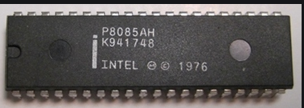
Introduction To Microprocessor
Microprocessors are integrated electrical circuits that are capable of carrying out the instructions of a computer software application or program.
A device that uses a microprocessor is normally capable of many functions, such as word processing, calculation, and communication via Internet or telephone.
Fig.1
https://www.daenotes.com/electronics/digital-electronics/Intel-8085-8-bit-microprocessor
2

Slide 3
CONTD…
The central processing unit (CPU) is a chip that functions as the brains of the computer.
It is made of transistors--millions of transistors, in fact.
Microprocessors are the circuitry that surround the CPU. The microprocessor is more than the CPU. It contains other processors, for example, the graphics processor unit. Sound cards and network cards are encased in microprocessors. So a CPU is part of a microprocessor, but a microprocessor is more than the CPU.
2

Slide 4
Contd..
μp is a programmable integrated device that has computing and decision making capability, similar to CPU of a computer.
Can be:
1) embedded in a larger system
2) a stand alone unit controlling processor
μp communicates and operates in the binary number 0 & 1, called bits.
Each μp has a fixed set of instructions in the form of binary patterns called machine language.
Notes:
<number>

Slide 5
Basic Concepts
Differences between:
Microcomputer – a computer with a microprocessor as its CPU. Includes memory, I/O etc.
Microprocessor – silicon chip which includes ALU, register circuits & control circuits
Microcontroller – silicon chip which includes microprocessor, memory & I/O in a single package.
2

Slide 6
What is a Microprocessor?
The word comes from the combination micro and processor.
Processor means a device that processes whatever comes as an input. In this context processor means a device that processes numbers, specifically binary numbers, 0’s and 1’s.
To process means to manipulate. It is a general term that describes all manipulation. Again in this content, it means to perform certain operations on the numbers that depend on the microprocessor’s design.
2

Slide 7
What about micro?
Micro is a new addition.
In the late 1960’s, processors were built using discrete elements.
These devices performed the required operation, but were too large and too slow.
In the early 1970’s the microchip was invented. All of the components that made up the processor were now placed on a single piece of silicon. The size became several thousand times smaller and the speed became several hundred times faster. The “Micro”Processor was born.

Slide 8
Basic Concepts
The μp applications are classified primarily in two categories:
Reprogrammable system (PC)
Embedded system (washing machine)
In embedded system, μp is a part of a final product and is not available for reprogramming to the end user.
Notes:
<number>

Slide 9
Definition of the Microprocessor
A μp is a multipurpose, programmable, clock-driven, register based electronic device that reads binary instructions from a storage device called memory, accepts binary data as input and process data according to those instructions and provides results as output.
Notes:
<number>

Slide 10
Definition (Contd.)
Lets expand each of the underlined words:
Programmable device: The microprocessor can perform different sets of operations on the data it receives depending on the sequence of instructions supplied in the given program.
By changing the program, the microprocessor manipulates
the data in different ways.
Instructions: Each microprocessor is designed to execute a specific group of operations. This group of operations is called an instruction set. This instruction set defines what the microprocessor can and cannot do.

Slide 11
Definition (Contd.)
accepts binary data : The data that the microprocessor manipulates must come from somewhere.
It comes from what is called “input devices”.
These are devices that bring data into the system from the outside world.
These represent devices such as a keyboard, a mouse, switches, etc.

Slide 12
Definition (Contd.)
– Binary Data(Numbers): The microprocessor has a very narrow view on life. It only understands binary numbers.
A binary digit is called a bit (which comes from binary digit).
The microprocessor recognizes and processes a group of bits together. This group of bits is called a “word”.
The number of bits in a Microprocessor’s word, is a measure of its “abilities”.

Slide 13
Definition (Contd.)
Words, Bytes, etc.
The earliest microprocessor (the Intel 8088 and Motorola’s 6800) recognized 8-bit words.
They processed information 8-bits at a time. That’s why they are called “8-bit processors”. They can handle large numbers, but in order to process these numbers, they broke them into 8-bit pieces and processed each group of 8-bits separately.
Later microprocessors (8086 and 68000) were designed with 16-bit words.
A group of 8-bits were referred to as a “half-word” or “byte”.
A group of 4 bits is called a “nibble”.
Also, 32 bit groups were given the name “long word”.
Today, all processors manipulate at least 32 bits at a time and there exists microprocessors that can process 64, 80, 128 bits

Slide 14
Definition (Contd.)
process data (Arithmetic and Logic Operations):
Every microprocessor has arithmetic operations such as add and subtract as part of its instruction set.
Most microprocessors will have operations such as multiply and divide.
Some of the newer ones will have complex operations such as square root.
In addition, microprocessors have logic operations as well. Such as AND, OR, XOR, shift left, shift right, etc.
Again, the number and types of operations define the microprocessor’s instruction set and depends on the specific microprocessor.

Slide 15
Definition (Contd.)
storage device called memory :
First, what is memory?
Memory is the location where information is kept while not in current use.
Memory is a collection of storage devices. Also, in many cases, these storage devices are grouped into groups of 8. These 8 storage locations can only be accessed together. So, one can only read or write in terms of bytes to and form memory.
Memory is usually measured by the number of bytes it can hold.
It is measured in Kilos, Megas and lately Gigas. A Kilo in computer language is 2¹⁰ =1024. So, a KB (KiloByte) is 1024 bytes. Mega is 1024 Kilos and Giga is 1024 Mega.

Slide 16
Definition (Contd.)
Stored in memory:
When a program is entered into a computer, it is stored in memory. Then as the microprocessor starts to execute the instructions, it brings the instructions from memory one at a time.
Memory is also used to hold the data.
– The microprocessor reads (brings in) the data from memory when it needs it and writes (stores) the results into memory when it is done.

Slide 17
Definition (Contd.)
provides results : For the user to see the result of the execution of the program, the results must be presented in a human readable form.
The results must be presented on an output device.
This can be the monitor, a paper from the printer, a simple LED or many other forms.

Slide 18
A Microprocessor-based system
From the above description, we can draw the following block diagram to represent a microprocessor-based system:
Input
Output
Memory

Slide 19
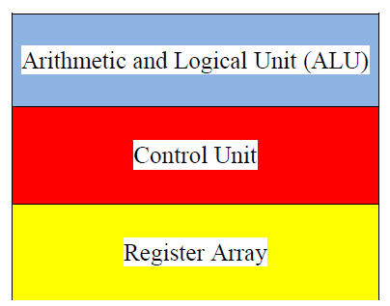
Inside The Microprocessor
Internally, the microprocessor is made up of 3 main units.
The Arithmetic/Logic Unit (ALU)
The Control Unit.
An array of registers for holding data while it is being manipulated.

Slide 20
Organization of a microprocessor-based system
Let’s expand the picture a bit.
I/O Input / Output
ALU | Register Array
Control
System Bus
Memory
ROM RAM

Slide 21
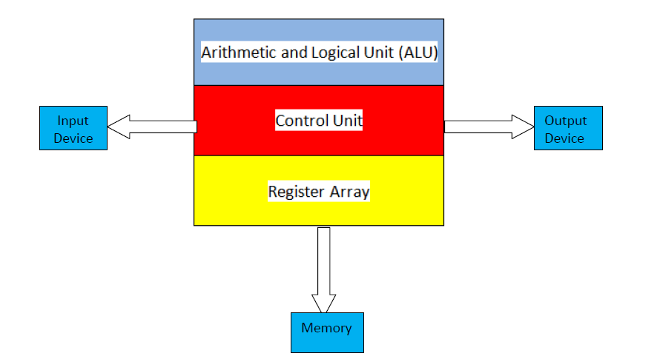
Microcomputer?
When a microprocessor, as central processing unit, combined with memory like RAM and ROM, and input/output circuitry, it becomes microcomputer
5

Slide 22
Basic components of a microprocessor
Arithmetic. and Logic Unit
Registers
Control Unit
Cache Memory
6

Slide 23
System Bus
Address Bus
Address bus carries address of memory.
Data Bus
A data bus used to transfer data from one module to another module.
Control bus
It comprised of various single lines that carry control signals.

Slide 24
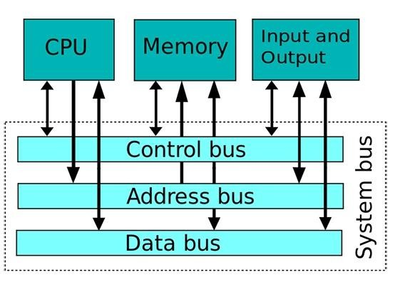
System Bus

Slide 25
Memory
Memory stores information such as instructions and data in binary format (0 and 1). It provides this information to the microprocessor whenever it is needed.
Usually, there is a memory “sub-system” in a microprocessor-based system. This sub-system includes:
The registers inside the microprocessor
Read Only Memory (ROM)
used to store information that does not change.
Random Access Memory (RAM) (also known as Read/Write Memory).
used to store information supplied by the user. Such as programs and data.

Slide 26
Memory Map and Addresses
The memory map is a picture representation of the address range and shows where the different memory chips are located within the address range.
₀₀₀₀ 0000
EPROM
RAM 1
RAM 2
RAM 3
RAM 4
Address Range of EPROM Chip
3FFF
4400
Address Range of 1st RAM Chip
5FFF
6000
Address Range of 2nd RAM Chip
Address Range
8FFF
9000
A3FF A400
Address Range of 3rd RAM Chip
Address Range of 4th RAM Chip
F7FF
FFFF

Slide 27
Memory
To execute a program:
the user enters its instructions in binary format into the memory.
The microprocessor then reads these instructions and whatever data is needed from memory, executes the instructions and places the results either in memory or produces it on an output device.

Slide 28
The three cycle instruction execution model
To execute a program, the microprocessor “reads” each instruction from memory, “interprets” it, then “executes” it.
To use the right names for the cycles:
The microprocessor fetches each instruction,
decodes it,
Then executes it.
This sequence is continued until all instructions are performed.

Slide 29
Machine Language
The number of bits that form the “word” of a microprocessor is fixed for that particular processor.
These bits define a maximum number of combinations.
For example an 8-bit microprocessor can have at most 2⁸ = 256 different combinations.
However, in most microprocessors, not all of these combinations are used.
Certain patterns are chosen and assigned specific meanings.
Each of these patterns forms an instruction for the microprocessor.
The complete set of patterns makes up the microprocessor’s machine language.

Slide 30
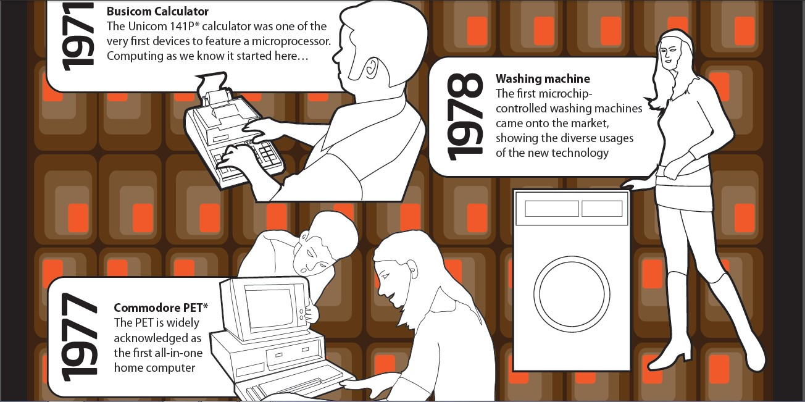
Evolution of Microprocessor

Slide 31

Evolution of Microprocessor

Slide 32
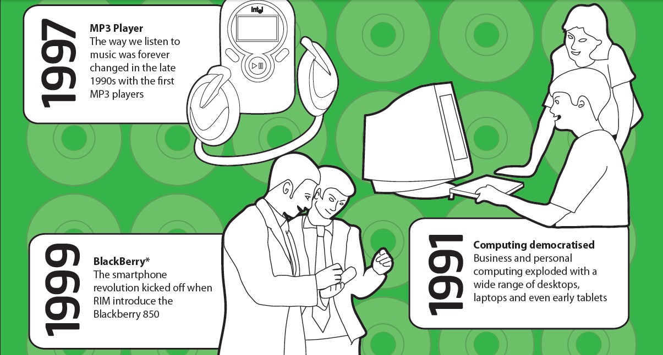
Evolution of Microprocessor

Slide 33
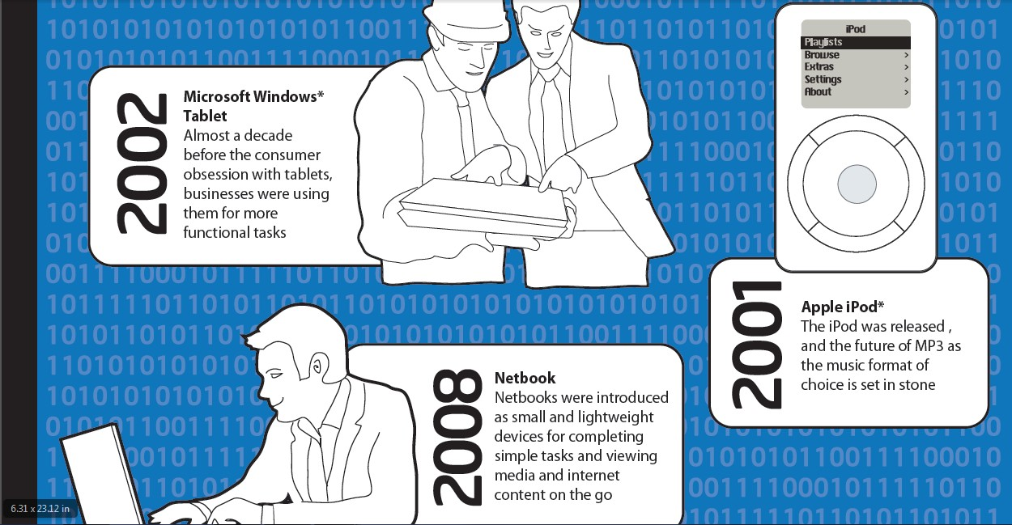
Evolution of Microprocessor

Slide 34

Evolution of Microprocessor

Slide 35
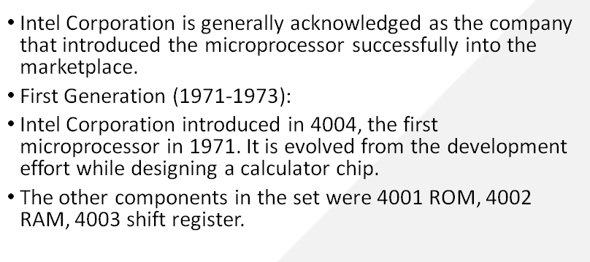
Evolution of Microprocessor

Slide 36
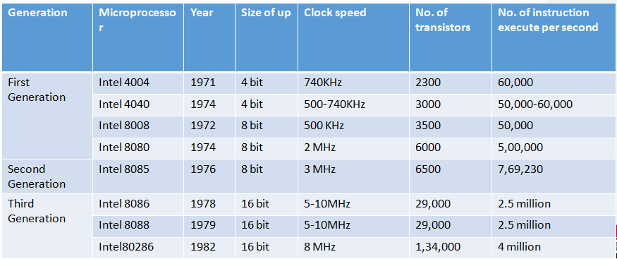
Evolution of Microprocessor

Slide 37
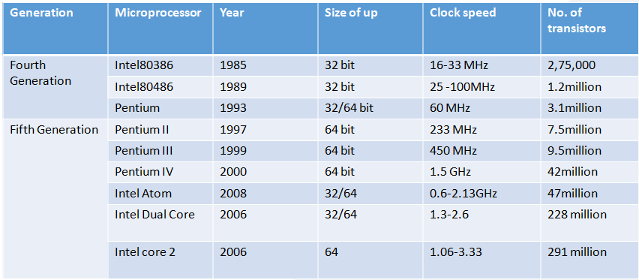
Evolution of Microprocessor

Slide 38
Evolution of Microprocessor
Generation | Microprocessor | Year | Clock speed
Fifth Generation | Intel core i3 | 2008 | 1.2-3.7 GHz
 | Intel core i5 | 2009 | 1.06-3.6 GHz
 | Intel core i7 | 2010 | 1.6-4.4 GHz

Slide 39

Architecture
Two Types of Architecture
Von Neumann Architecture
Harvard Architecture
Von Neumann
First proposed by John von Neumann
Only one data path for both instructions and data
Hence CPU does one operation at a time
Simpler hardware design, Flexible program and Data storage
Apex Institute of Technology- CSE

Slide 40
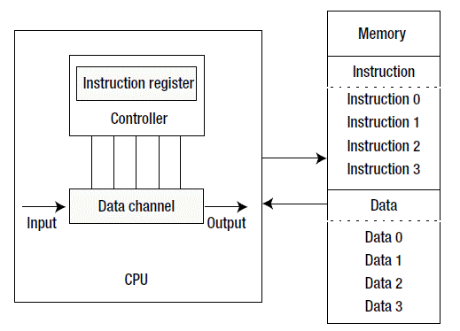
Von Neumann Architecture
Apex Institute of Technology- CSE

Slide 41
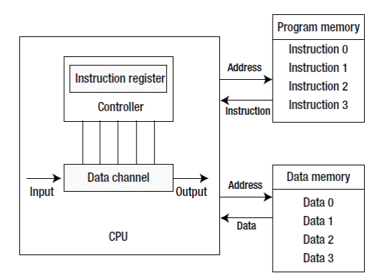
Harvard Architecture
Compared with the Von Neumann architecture, a Harvard architecture processor has two outstanding features.
First, instructions and data are stored in two separate memory modules; instructions and data do not coexist in the same module.
Second, two independent buses are used as dedicated communication paths between the CPU and memory; there is no connection between the two buses
Because of greater memory
bandwidth, it becomes greater
choice for data signal processing
Apex Institute of Technology- CSE

Slide 42
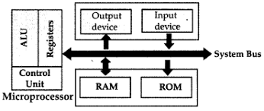
Microprocessor
Multipurpose, Programmable device
Accepts data as input
Processes data as per instructions stored in memory
Produces output
Apex Institute of Technology- CSE

Slide 43
Microprocessor
Three basic characteristics:
Instruction Set:
A command given to a digital machine to perform an operation on a piece of data is called an instruction
The possible operations a microprocessor can execute, is determined through its instruction set
Word Size:
The numbers of bits processed in single instruction is called its word size. 32-bit processor means it has a word size of 32 bits.
Word size determines the amount of RAM that can be accessed at one go and total number of pins on the microprocessor
Clock Speed:
The speed at which the microprocessor executes instructions is called clock speed
Clock speeds are measured in MHz or GHz where 1 MHz means 1 million cycles per second whereas 1 GHz equals to 1 billion cycles per second
Apex Institute of Technology- CSE

Slide 44
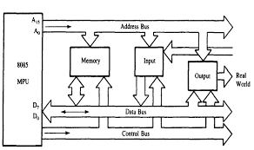
Microprocessor
Three Buses:
- Address Bus: Unidirectional, responsible for carrying address of a memory location or I/O port from CPU to memory or I/O port.
- Data Bus: Lines that carry data to and from memory are called data bus.
It is a bidirectional bus with width equal to word length of the microprocessor.
- Control Bus: Lines that carry control signals like clock signals, interrupt signal or ready signal are called control bus.
Apex Institute of Technology- CSE

Slide 45
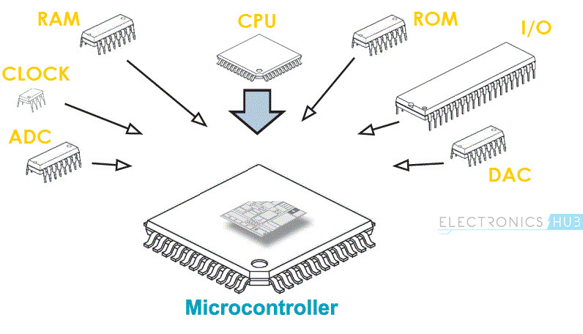
Microcontroller
A Microcontroller is a VLSI Integrated Circuit (IC) that contains electronic computing unit and logic unit, Memory I/O Ports (Input / Output Ports) and few other components integrated on a single chip.
Also called as a Computer-on-a-Chip or a Single-Chip-Computer
Apex Institute of Technology- CSE

Slide 46
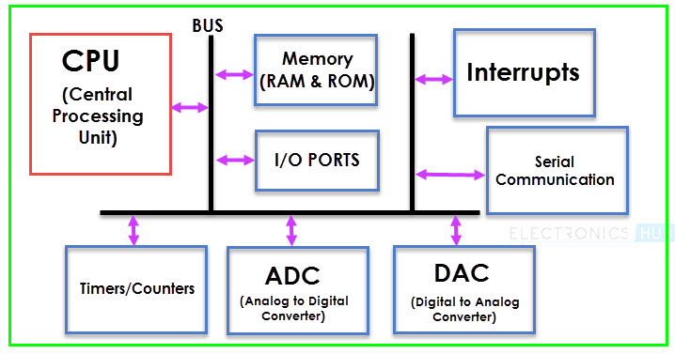
Embedded System Microcontroller
Apex Institute of Technology- CSE

Slide 47
Embedded System Microcontroller
CPU
Central Processing Unit or CPU is the brain of the Microcontroller. It consists of an Arithmetic Logic Unit (ALU) and a Control Unit (CU). A CPU reads, decodes and executes instructions to perform Arithmetic, Logic and Data Transfer operations.
Memory
The various memories installed inside the microcontroller are RAM and ROM (EEPROM, EPROM, etc) or flash memories for storing program source codes.
I/O Ports
The interface for the Microcontroller to the external world is provided by the I/O Ports or Input/Output Ports. Inputs device like Switches, Keypads, etc. provide information from the user to the CPU in the form of Binary Data. The CPU, upon receiving the data from the input devices, executes appropriate instructions and gives response through Output Devices like LEDs, Displays, Printers, etc.
Apex Institute of Technology- CSE

Slide 48
Embedded System Microcontroller
Timers and Counters
Mainly they are used for the purpose of lock functions, modulations, pulse generations, frequency measuring and making oscillations so that the task can be performed with the stipulated time interval.
Bus
A System bus is a group of connecting wire that connect the CPU with other peripherals like Memory, I/O Ports and other supporting components
Serial Port
One of the important requirement of a Microcontroller is to communicate with other device and peripherals (external). Serial Port proves such interface through serial communication. Most common serial communication implemented in Microcontrollers is UART.
Apex Institute of Technology- CSE

Slide 49
Embedded System Microcontroller
Interrupts
A very important feature of a Microcontroller is Interrupts and its Interrupt Handling Mechanism. Interrupts can be external, internal, hardware related or software related.
ADC (Analog to Digital Converter)
The ADC Circuit forms the interface between the external Analog Input devices and the CPU of the Microcontroller. Almost all sensors are analog devices and the analog data from these sensors must be converted in to digital data for the CPU to understand.
DAC (Digital to Analog Converter)
Digital to Analog Converter or DAC is a circuit, that works in contrast to an ADC i.e. it converts Digital Signals to Analog Signals. DAC forms the bridge between the CPU of the Microcontroller and the external analog devices.
Apex Institute of Technology- CSE

Slide 50
Computer Organization RISC Vs CISC
CISC (Complex Instruction Set Computers)
Richer instruction set, some simple, some very complex
Instructions are of variable length
Instructions take more than one clock cycle usually
Work well with simpler compilers
Examples: Intel 386 & 486, Pentium, Pentium II and III, Motorola 68000, etc.
Apex Institute of Technology- CSE

Slide 51
Embedded System RISC Vs CISC
RISC (Reduced Instruction Set Computers)
Simple primitive instructions and addressing modes
Usually Instructions execute in one clock cycle
Uniformed length instructions
Complexity pushed to the compiler
Supports fewer instructions
For example, Pentium1, AMD K6, Intel P6, ARM etc
Apex Institute of Technology- CSE

Slide 52
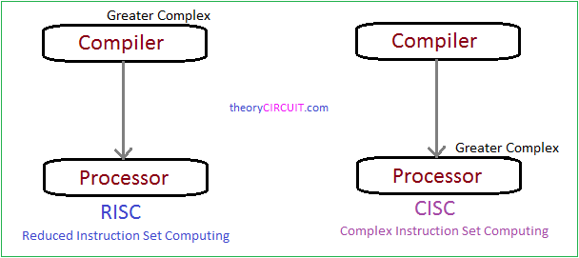
Embedded System RISC Vs CISC
Apex Institute of Technology- CSE

Slide 53
Architecture of microprocessor 8086
Course Outcome
This will be covered in this
lecture
CO Number | Title | Level
CO1 | Students will be able to differentiate between families of processors based on architectural requirements. | Understand
CO2 | Students will be able to compare the features of the processors based on the design requirements of the system. | Understand
CO3 | Students will be able to understand different communication protocols for hardware interfacing. | Understand
2

Slide 54
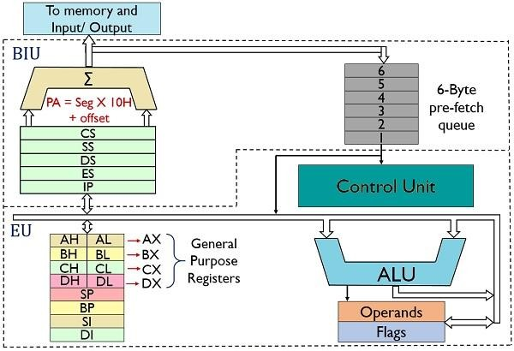
8086 Architecture
<number>

Slide 55
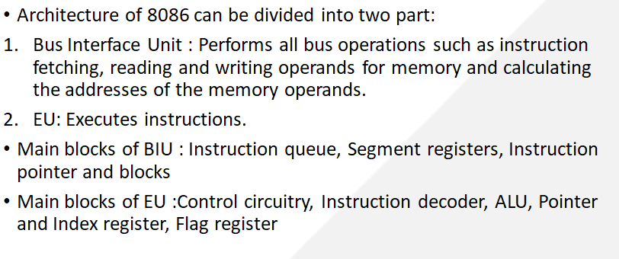
8086 Architecture
<number>

Slide 56
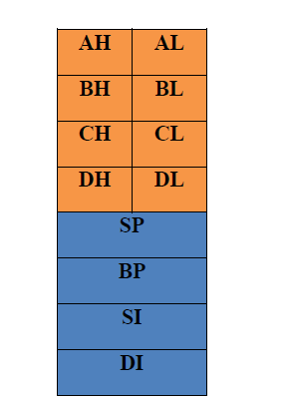
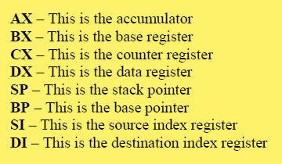
8086 Registers
General Purpose Registers
<number>

Slide 57
Physical Memory
Physical Memory Organization in 8086
Code segment (64KB)
Data segment (64KB)
Extra segment (64KB)
Stack segment (64KB)
00000
Since 8086 has 20 address lines. It can access 2^20=1 MB
Memory address in 1 MB ranges from 00000H to FFFFFH
Memory is constructed using RAM, ROM and EPROM chips
1 MB
FFFFF
57
Notes:
<number>

Slide 58
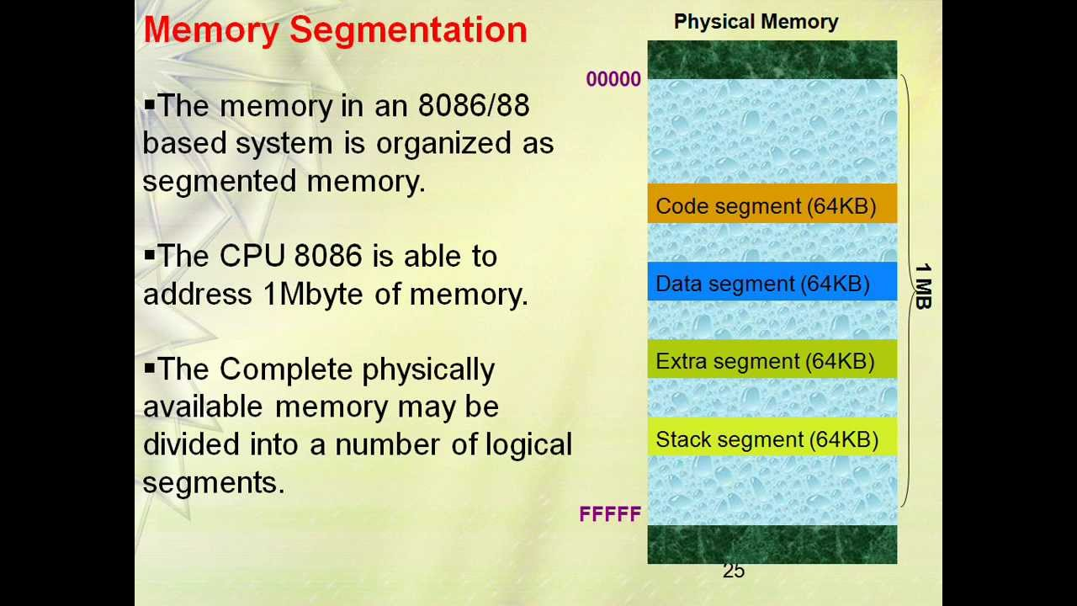
MEMORY
00000
BIU
Segment Registers
34BA0
CODE (64k)
44B9F
CSR
34BA
44EB
54EB
695E
44EB0
DATA (64K)
54EAF
1 MB
DSR
54EB0
ESR
EXTRA (64K)
64EAF
SSR
695E0
STACK (64K)
795DF
Figure 5:[4]
57

Slide 59
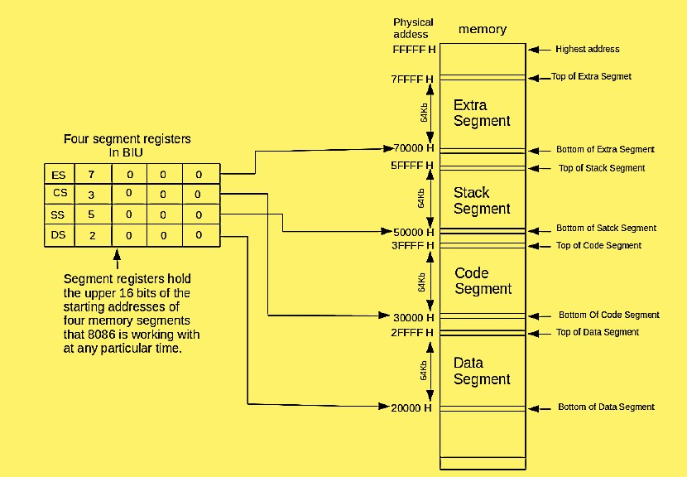
Memory Segmentation
8086 memory is divided into four segments.
Extra Segment
Stack Segment
Code Segment
Data Segment
57

Slide 60
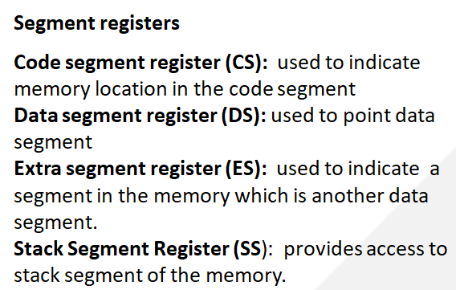
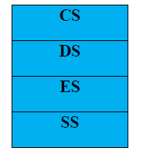
8086 Registers
<number>

Slide 61
How to find base address?
Base address of any segment can be obtained by adding four binary 0’s to the right portion of the content of corresponding segment register
It is like shifting the content of the segment registers to the right by 4 bits.
E.g: If the value of CS is 2000H , base address of CS is obtained by adding 4 binary digits or 1 Hexadecimal zero to the content of CS : 20000H
Formula : BA*10H

Slide 62
CS
34BA
IP
8AB4
Code segment
The following examples shows the CS:IP scheme of address formation:
Inserting a hexadecimal 0H (0000B)
with the CSR or shifting the CSR
four binary digits left
34BA0
8AB4 (offset)
3D645
3 4 B A 0 ( C S ) +
8 A B 4 ( I P )
3 D 6 5 4 (next address)
44B9F

Slide 63
Example For Address Calculation (segment: offset)
If the data segment starts at location 1000h and a data reference contains the address 29h where is the actual data?
Offset
0000 0000 0010 1001
Segment Address
0001 0000 0000 0000
0000
Required Address
0001 0000 0000 0010 1001

Slide 64
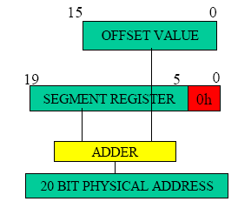

Slide 65
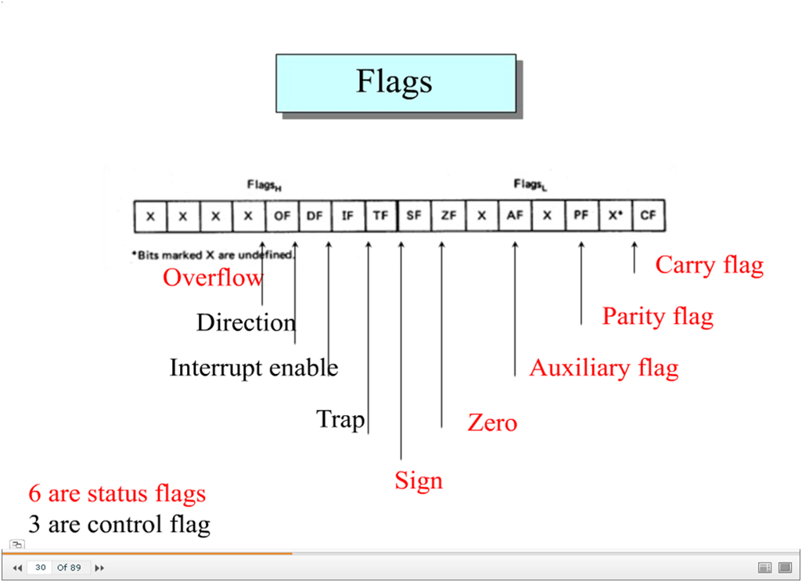
8086 Flag Register
<number>

Slide 66
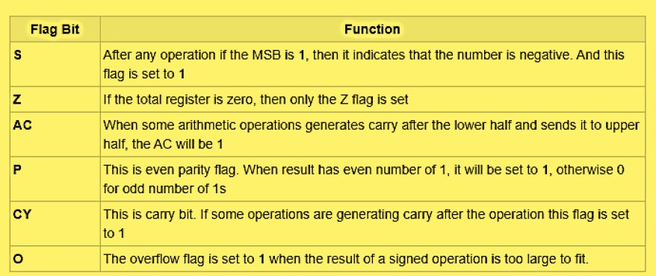
8086 Flag Registers
Status Flags
<number>

Slide 67
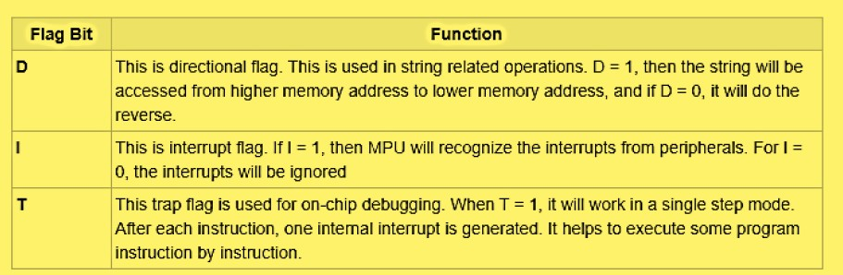
8086 Flag Registers
Control Flags
<number>

Slide 68
Pin description of microprocessor 8086
Course Outcome
This will be covered in this
lecture
CO Number | Title | Level
CO1 | Students will be able to differentiate between families of processors based on architectural requirements. | Understand
CO2 | Students will be able to compare the features of the processors based on the design requirements of the system. | Understand
CO3 | Students will be able to understand different communication protocols for hardware interfacing. | Understand
2

Slide 69
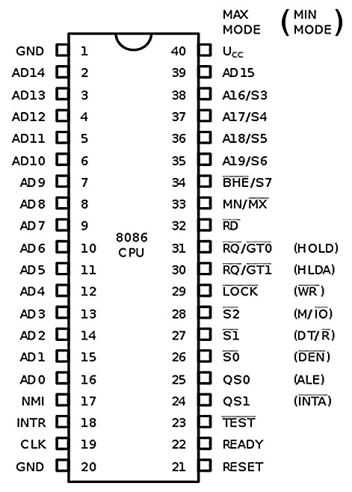
8086 Pin description
<number>

Slide 70
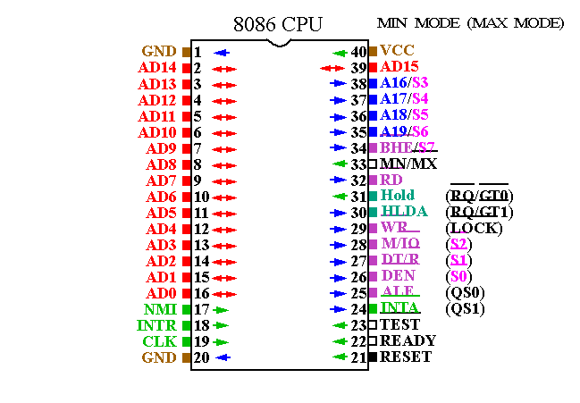
Figure 1: [1]

Slide 71
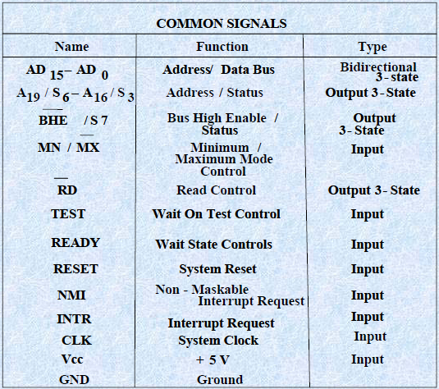
Internal Architecture of 8086 (cont..)
Figure 2:[2]

Slide 72
Various Pins of 8086
Pins common to Minimum and Maximum modes:
AD15-AD0
A19/S6
A18/S5
A17/S4
A16/S4
BHE’/S7
RD’
READY
INTR
TEST
CLK
MN/MX

Slide 73
Power supply and frequency signals
It uses 5V DC supply at VCC pin 40, and uses ground at VSS pin 1 and 20 for its operation.
Clock signal
Clock signal is provided through Pin-19. It provides timing to the processor for operations. Its frequency is different for different versions, i.e. 5MHz, 8MHz and 10MHz.
Address/data bus
AD0-AD15. These are 16 address/data bus. AD0-AD7 carries low order byte data and AD8AD15 carries higher order byte data. During the first clock cycle, it carries 16-bit address and after that it carries 16-bit data.

Slide 74
Address/status bus
A16-A19/S3-S6. These are the 4 address/status buses. During the first clock cycle, it carries 4-bit address and later it carries status signals.
S7/BHE’
BHE’ stands for Bus High Enable. It is available at pin 34 and used to indicate the transfer of data using data bus D8-D15. This signal is low during the first clock cycle, thereafter it is active.
Read(RD’)
It is available at pin 32 and is used to read signal for Read operation.

Slide 75
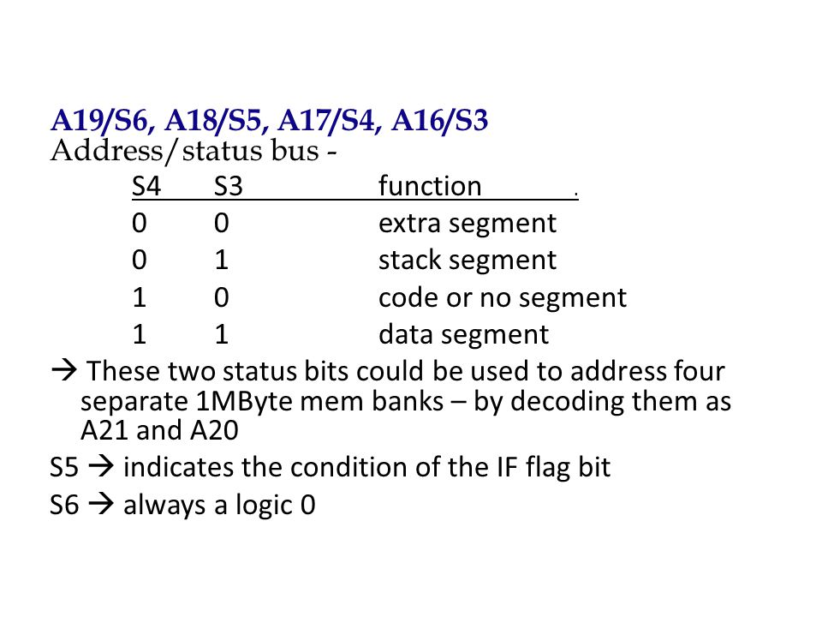

Slide 76
Ready
It is available at pin 22. It is an acknowledgement signal from I/O devices that data is transferred. It is an active high signal. When it is high, it indicates that the device is ready to transfer data. When it is low, it indicates wait state.
INTR
It is available at pin 18. It is an interrupt request signal, which is sampled during the last clock cycle of each instruction to determine if the processor considered this as an interrupt or not.
NMI
It stands for non-maskable interrupt and is available at pin 17. It is an edge triggered input, which causes an interrupt request to the microprocessor.

Slide 77
TEST
This signal is like wait state and is available at pin 23. When this signal is high, then the processor has to wait for IDLE state, else the execution continues.
MN/MX’
It stands for Minimum/Maximum and is available at pin 33. It indicates what mode the processor is to operate in; when it is high, it works in the minimum mode and vice-versa.
INTA’
It is an interrupt acknowledgement signal and available at pin 24. When the microprocessor receives this signal, it acknowledges the interrupt.

Slide 78
TWO OPERATING MODES OF 8086
•The minimum mode is selected by applying logic 1 to the MN / MX input pin. This is a single microprocessor configuration.
•The maximum mode is selected by applying logic 0 to the MN / MX input pin. This is a multi micro processors configuration.

Slide 79
Operating Modes of 8086
Course Outcome
This will be covered in this
lecture
CO Number | Title | Level
CO1 | Students will be able to differentiate between families of processors based on architectural requirements. | Understand
CO2 | Students will be able to compare the features of the processors based on the design requirements of the system. | Understand
CO3 | Students will be able to understand different communication protocols for hardware interfacing. | Understand
2

Slide 80
Minimum & Maximum Mode Interface
8086 Works in 2 modes
Minimum : All control signals for memory and I/O are generated by 8086. It is a uniprocessor configuration.
Maximum : Some control signals are generated externally which requires the addition of external bus controller such as 8288 to 8086. It is a multiprocessor configuration.

Slide 81
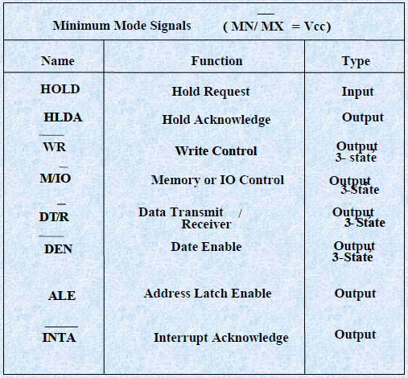
Internal Architecture of 8086 (cont..)
Figure 3:[3]

Slide 82
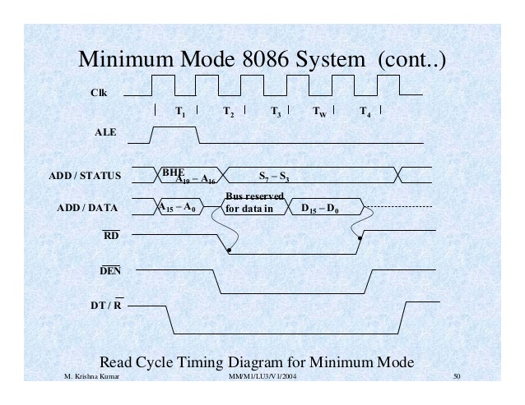
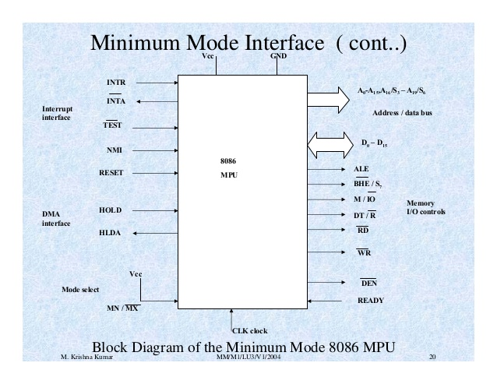
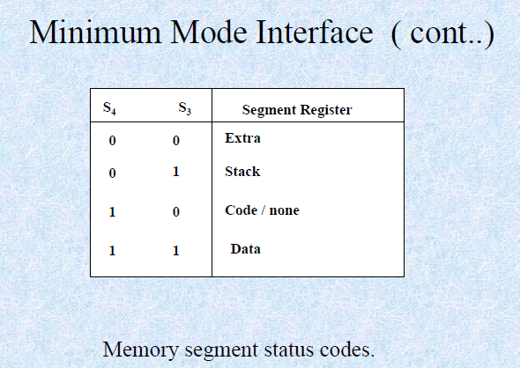
Figure 5:[5]

Slide 83
ALE
It stands for address enable latch and is available at pin 25. A positive pulse is generated each time the processor begins any operation. This signal indicates the availability of a valid address on the address/data lines.
DEN’
It stands for Data Enable and is available at pin 26. It is used to enable Transceiver 8286. The transceiver is a device used to separate data from the address/data bus.
DT/R’
It stands for Data Transmit/Receive signal and is available at pin 27. It decides the direction of data flow through the transceiver. When it is high, data is transmitted out and vice-a-versa.

Slide 84
M/IO’
This signal is used to distinguish between memory and I/O operations. When it is high, it indicates MEMORY operation and when it is low indicates the I/O operation. It is available at pin 28.
WR’
It stands for write signal and is available at pin 29. It is used to write the data into the memory or the output device depending on the status of M/IO signal.
HLDA
It stands for Hold Acknowledgement signal and is available at pin 30. This signal acknowledges the HOLD signal.
HOLD
This signal indicates to the processor that external devices are requesting to access the address/data buses. It is available at pin 31.

Slide 85
QS1 and QS0
These are queue status signals and are available at pin 24 and 25. These signals provide the status of instruction queue. Their conditions are shown in the following table −
QS0 | QS1 | Status
0 | 0 | No operation
0 | 1 | First byte of opcode from the queue
1 | 0 | Empty the queue
1 | 1 | Subsequent byte from the queue

Slide 86
S0, S1, S2
These are the status signals that provide the status of operation, which is used by the Bus Controller 8288 to generate memory & I/O control signals. These are available at pin 26, 27, and 28. Following is the table showing their status
S2 S1 S0 CHARACTERISTICS
0 0 0 Interrupt acknowledge
0 0 1 Read I/O port
0 1 0 Write I/O port
0 1 1 Halt
1 0 0 Code access
1 0 1 Read memory
1 1 0 Write memory
1 1 1 Passive state

Slide 87
LOCK’
When this signal is active, it indicates to the other processors not to ask the CPU to leave the system bus. It is activated using the LOCK prefix on any instruction and is available at pin 29.
RQ’/GT1’ and RQ’/GT0’
These are the Request/Grant signals used by the other processors requesting the CPU to release the system bus. When the signal is received by CPU, then it sends acknowledgment. RQ/GT0 has a higher priority than RQ/GT1.

Slide 88
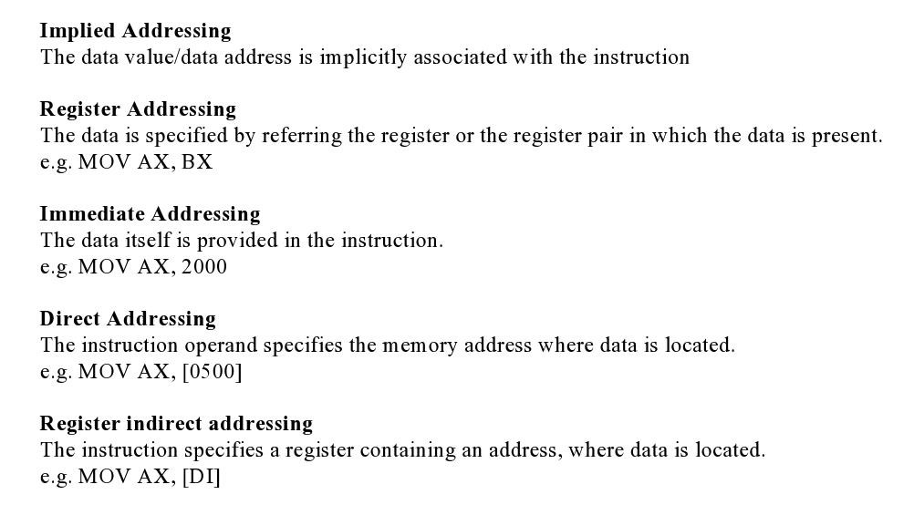
Addressing Modes
<number>

Slide 89
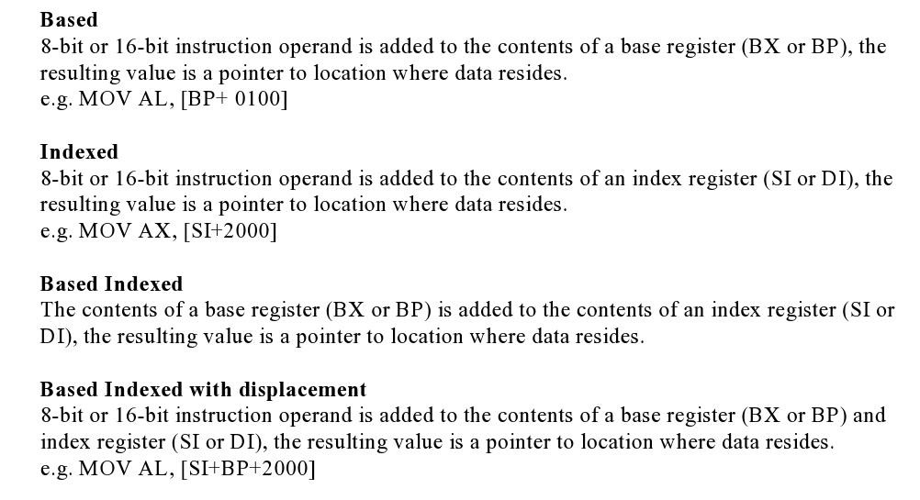
Addressing Modes
<number>

Slide 90
Operating Modes of 8086
Course Outcome
This will be covered in this
lecture
CO Number | Title | Level
CO1 | Students will be able to differentiate between families of processors based on architectural requirements. | Understand
CO2 | Students will be able to compare the features of the processors based on the design requirements of the system. | Understand
CO3 | Students will be able to understand different communication protocols for hardware interfacing. | Understand
2

Slide 91
Instruction Set of 8086
An instruction is a binary pattern designed inside a microprocessor to perform a specific function.
The entire group of instructions that a microprocessor supports is called Instruction Set.
8086 has more than 20,000 instructions.
<number>
ohmshankar.ece@act.edu.in
21-Nov-2010
Notes:
<number>

Slide 92
Classification of Instruction Set
1. Arithmetic Instructions and Logical Instruction
2. Data Transfer Instructions
3. Branch and Loop Instruction
4. M/C control Instruction
5. Flag Manipulation Instructions
6. Shift and Rotate Instruction
7. String Instructions
<number>
Notes:
<number>

Slide 93
1. Arithmetic And Logical Instructions
Notes:
<number>

Slide 94
Arithmetic Instructions
ADD Des, Src:
It adds a byte to byte or a word to word.
It effects AF, CF, OF, PF, SF, ZF flags.
E.g.:
ADD AL, 74H
ADD DX, AX
ADD AX, [BX]
<number>
Notes:
<number>

Slide 95
Arithmetic Instructions
ADC Des, Src:
It adds the two operands with CF.
It effects AF, CF, OF, PF, SF, ZF flags.
E.g.:
ADC AL, 74H
ADC DX, AX
ADC AX, [BX]
<number>
Notes:
<number>

Slide 96
Arithmetic Instructions
SUB Des, Src:
It subtracts a byte from byte or a word from word.
It effects AF, CF, OF, PF, SF, ZF flags.
For subtraction, CF acts as borrow flag.
E.g.:
SUB AL, 74H
SUB DX, AX
SUB AX, [BX]
<number>
Notes:
<number>

Slide 97
Arithmetic Instructions
SBB Des, Src:
It subtracts the two operands and also the borrow from the result.
It effects AF, CF, OF, PF, SF, ZF flags.
E.g.:
SBB AL, 74H
SBB DX, AX
SBB AX, [BX]
<number>
Notes:
<number>

Slide 98
Arithmetic Instructions
MUL Src:
It is an unsigned multiplication instruction.
It multiplies two bytes to produce a word or two words to produce a double word.
AX = AL * Src
DX : AX = AX * Src
This instruction assumes one of the operand in AL or AX.
Src can be a register or memory location. And Flags-OF, CF
Unused bits of destination register is always filled with sign bit
IMUL Src:
It is a signed multiplication instruction.
<number>
Notes:
<number>

Slide 99
Arithmetic Instructions
DIV Src:
It is an unsigned division instruction.
It divides word by byte or double word by word.
The operand is stored in AX, divisor is Src and the result is stored as:
AH = remainder, AL = quotient (for word/byte)
DX=remainder, AX=quotient (for D-word/word)
IDIV Src:
It is a signed division instruction.
<number>
Notes:
<number>

Slide 100
Arithmetic Instructions
CBW (Convert Byte to Word):
This instruction converts byte in AL to word in AX.
The conversion is done by extending the sign bit of AL throughout AH.
CWD (Convert Word to Double Word):
This instruction converts word in AX to double word in DX : AX.
The conversion is done by extending the sign bit of AX throughout DX.
<number>
Notes:
<number>

Slide 101
Arithmetic Instructions
INC Src:
It increments the byte or word by one.
The operand can be a register or memory location.
E.g.: INC AX
INC [SI]
<number>
Notes:
<number>

Slide 102
Arithmetic Instructions
DEC Src:
It decrements the byte or word by one.
The operand can be a register or memory location.
E.g.: DEC AX
DEC [SI]
<number>
Notes:
<number>

Slide 103
Arithmetic Instructions
CMP Des, Src:
It compares two specified bytes or words.
The Src and Des can be a constant, register or memory location.
Both operands cannot be a memory location at the same time.
The comparison is done simply by internally subtracting the source from destination.
The value of source and destination does not change, but the flags CF, ZF, SF are modified to indicate the result.
<number>
Notes:
<number>

Slide 104
Arithmetic Instructions
NEG Src:
It creates 2’s complement of a given number.
That means, it changes the sign of a number.
<number>
Notes:
<number>

Slide 105
Arithmetic Instructions
DAA (Decimal Adjust after Addition)
It is used to make sure that the result of adding two BCD numbers is adjusted to be a correct BCD number.
It only works on AL register.
For Subtraction : DAS (Decimal Adjust after Subtraction)
<number>
Notes:
<number>

Slide 106
Arithmetic Instructions
AAA (ASCII Adjust after Addition):
This Instruction Can be used to convert the contents of the AL register to unpacked BCD result
i.e. If lower nibble of AL>9 then
1. AL=AL+6 2. AH=AH+1
3. AL=AL AND 0FH
This instruction does not have any operand.
Other ASCII Instructions:
AAS (ASCII Adjust after Subtraction)
AAM (ASCII Adjust after Multiplication)
AAD (ASCII Adjust Before Division)
<number>
Notes:
<number>

Slide 107
Logical Instructions
NOT Src:
It complements each bit of Src to produce 1’s complement of the specified operand.
The operand can be a register or memory location.
e,.g NOT AX
<number>
Notes:
<number>

Slide 108
Logical Instructions
AND Des, Src:
It performs AND operation of Des and Src.
Src can be immediate number, register or memory location.
Des can be register or memory location.
Both operands cannot be memory locations at the same time.
CF and OF become zero after the operation.
PF, SF and ZF are updated.
<number>
Notes:
<number>

Slide 109
Bit Manipulation Instructions
OR Des, Src:
It performs OR operation of Des and Src.
Src can be immediate number, register or memory location.
Des can be register or memory location.
Both operands cannot be memory locations at the same time.
CF and OF become zero after the operation.
PF, SF and ZF are updated.
<number>
Notes:
<number>

Slide 110
Bit Manipulation Instructions
XOR Des, Src:
It performs XOR operation of Des and Src.
Src can be immediate number, register or memory location.
Des can be register or memory location.
Both operands cannot be memory locations at the same time.
CF and OF become zero after the operation.
PF, SF and ZF are updated.
<number>
Notes:
<number>

Slide 111
Bit Manipulation Instructions
TEST Des, Src:
It performs AND operation of Des and Src.
Src can be immediate number, and src/Des can be register or memory location.
It is Non-Destructive And means Dest is not modified only flags are affected.
Both operands cannot be memory locations at the same time.
CF and OF become zero after the operation.
PF, SF and ZF are updated.
<number>
Notes:
<number>

Slide 112
2. Data Transfer Instructions
<number>
Notes:
<number>

Slide 113
Data Transfer Instructions
MOV Des, Src:
It is used to copy the content of Src to Des
Src operand can be register, memory location or immediate operand.
Des can be register or memory operand.
Both Src and Des cannot be memory location at the same time.
E.g.:
MOV CX, 037A H
MOV AL, BL
MOV BX, [0301 H]
<number>
Notes:
<number>

Slide 114
Data Transfer Instructions
PUSH Operand:
It pushes the operand into top of stack.
E.g.: PUSH BX
POP Des:
It pops the operand from top of stack to Des.
Des can be a general purpose register, segment register (except CS) or memory location.
E.g.: POP AX
<number>
Notes:
<number>

Slide 115
Data Transfer Instructions
XCHG Des, Src:
This instruction exchanges Src with Des.
It cannot exchange two memory locations directly.
E.g.: XCHG DX, AX
<number>
Notes:
<number>

Slide 116
Data Transfer Instructions
IN Accumulator, Port Address:
It transfers the operand from specified port to accumulator register.
E.g.: IN AX, 0028 H
OUT Port Address, Accumulator:
It transfers the operand from accumulator to specified port.
E.g.: OUT 0028 H, AX
<number>
Notes:
<number>

Slide 117
Data Transfer Instructions
LEA Register, Src:
It loads a 16-bit register with the offset address of the data specified by the Src.
E.g.: LEA BX, [DI]
This instruction loads the contents of DI (offset) into the BX register.
<number>
Notes:
<number>

Slide 118
Data Transfer Instructions
LDS Des, Src:
It loads 32-bit pointer from memory source to destination register and DS.
The word is placed in the destination register and the segment is placed in DS.
This instruction Copies the word at the lower memory address to the Des reg and the word at the higher address to the segment reg i.e. DS.
E.g.: LDS BX, [0301 H]
<number>
Notes:
<number>

Slide 119
Data Transfer Instructions
LES Des, Src:
It loads 32-bit pointer from memory source to destination register and ES.
The Word is placed in the destination register and the segment is placed in ES.
This instruction is very similar to LDS except that it initializes ES instead of DS.
E.g.: LES BX, [0301 H]
<number>
Notes:
<number>

Slide 120
Data Transfer Instructions
LAHF:
It copies the lower byte of flag register to AH.
SAHF:
It copies the contents of AH to lower byte of flag register.
PUSHF:
Pushes flag register to top of stack.
POPF:
Pops the stack top to flag register.
<number>
Notes:
<number>

Slide 121
3. Branch/Program Execution Transfer Instructions
These instructions cause change in the sequence of the execution of instruction.
This change can be a conditional or sometimes unconditional.
The conditions are represented by flags.
<number>
Notes:
<number>

Slide 122
Branch Instructions
CALL Des:
This instruction is used to call a subroutine or function or procedure.
The address of next instruction after CALL is saved onto stack.
RET:
It returns the control from procedure to calling program.
Every CALL instruction should have a RET.
<number>
Notes:
<number>

Slide 123
Branch Instructions
JMP Des:
This instruction is used for unconditional jump from one place to another.
Jxx Des (Conditional Jump):
All the conditional jumps follow some conditional statements or any instruction that affects the flag.
<number>
Notes:
<number>

Slide 124
Conditional Jump Table
Mnemonic | Meaning | Jump Condition
JA | Jump if Above | CF = 0 and ZF = 0
JAE | Jump if Above or Equal | CF = 0
JB | Jump if Below | CF = 1
JBE | Jump if Below or Equal | CF = 1 or ZF = 1
JC | Jump if Carry | CF = 1
JE | Jump if Equal | ZF = 1
JNC | Jump if Not Carry | CF = 0
JNE | Jump if Not Equal | ZF = 0
JNZ | Jump if Not Zero | ZF = 0
JPE | Jump if Parity Even | PF = 1
JPO | Jump if Parity Odd | PF = 0
JZ | Jump if Zero | ZF = 1
<number>
Notes:
<number>

Slide 125
Loop Instructions
Loop Des:
This is a looping instruction.
The number of times looping is required is placed in the CX register.
With each iteration, the contents of CX are decremented.
ZF is checked whether to loop again or not.
<number>
Notes:
<number>

Slide 126
Program Execution Transfer Instructions
INTO (Interrupt on overflow):
This instruction generates type 4 interrupt (i.e. interrupt for overflow) and causes the 8086 to do an indirect far call a procedure which is written by the user to handle the overflow condition.
IRET
To return the execution to the interrupted program
<number>
Notes:
<number>

Slide 127
4. Machine Control Instructions
Notes:
<number>

Slide 128
Machine Control Instructions
HLT (Halt) :- It causes the processor to enter in to the halt state. It can be stop by INTR,NMI or RESET pin
NOP (No Opration) :- It causes the processor to enter in to the wait state for 3 Clock cycles.
WAIT :- It causes the processor to enter in to the ideal state. Can be stop by TEST, INTR OR NMI pin
LOCK :- This instruction prevents other processors to take the control of shared resources. For e.g LOCK IN AL,80H
<number>
Notes:
<number>

Slide 129
5. Flag Manipulation Instructions
Notes:
<number>

Slide 130
Flag Manipulation Instructions
STC:
It sets the carry flag to 1.
CLC:
It clears the carry flag to 0.
CMC:
It complements the carry flag.
<number>
Notes:
<number>

Slide 131
Flag Manipulation Instructions
STD:
It sets the direction flag to 1.
If it is set, string bytes are accessed from higher memory address to lower memory address.
CLD:
It clears the direction flag to 0.
If it is reset, the string bytes are accessed from lower memory address to higher memory address.
<number>
Notes:
<number>

Slide 132
Flag Manipulation Instructions
STI:
It sets the Interrupt flag to 1.
CLI:
It clears the Interrupt flag to 0.
<number>
Notes:
<number>

Slide 133
6. Shift And Rotate Instructions
Notes:
<number>

Slide 134
Shift And Rotate Instructions
SHL/SAL Des, Count:
It shift bits of byte or word left, by count.
It puts zero(s) in LSBs.
MSB is shifted into carry flag.
If the number of bits desired to be shifted is 1, then the immediate number 1 can be written in Count.
However, if the number of bits to be shifted is more than 1, then the count is put in CL register. And recent bit to the CF (Carry flag)
<number>
Notes:
<number>

Slide 135
Shift And Rotate Instructions
SHR/SAR Des, Count:
It shift bits of byte or word right, by count.
It puts zero(s)(for SHL) and Sign bit (for SAL) in MSBs.
LSB is shifted into carry flag.
If the number of bits desired to be shifted is 1, then the immediate number 1 can be written in Count.
However, if the number of bits to be shifted is more than 1, then the count is put in CL register. And recent bit to the CF (Carry flag)
<number>
Notes:
<number>

Slide 136
Shift And Rotate Instructions
ROL Des, Count:
It rotates bits of byte or word left, by count.
LSB is transferred to MSB and also to CF.
If the number of bits desired to be shifted is 1, then the immediate number 1 can be written in Count.
However, if the number of bits to be shifted is more than 1, then the count is put in CL register. And recent bit to the CF (Carry flag)
<number>
Notes:
<number>

Slide 137
Shift And Rotate Instructions
ROR Des, Count:
It rotates bits of byte or word right, by count.
MSB is transferred to LSB and also to CF.
If the number of bits desired to be shifted is 1, then the immediate number 1 can be written in Count.
However, if the number of bits to be shifted is more than 1, then the count is put in CL register. And recent bit to the CF (Carry flag)
<number>
Notes:
<number>

Slide 138
Shift And Rotate Instructions
RCL Des, Count:
It rotates bits of byte or word right, by count.
LSB to MSB then MSB is transferred to CF and CF to LSB.
If the number of bits desired to be shifted is 1, then the immediate number 1 can be written in Count.
However, if the number of bits to be shifted is more than 1, then the count is put in CL register. And recent bit to the CF (Carry flag)
<number>
Notes:
<number>

Slide 139
Shift And Rotate Instructions
RCR Des, Count:
It rotates bits of byte or word left, by count.
MSB to LSB then LSB is transferred to CF and CF to MSB.
If the number of bits desired to be shifted is 1, then the immediate number 1 can be written in Count.
However, if the number of bits to be shifted is more than 1, then the count is put in CL register. And recent bit to the CF (Carry flag)
<number>
Notes:
<number>

Slide 140
7. String Manipulation Instructions
Notes:
<number>

Slide 141
String Manipulation Instructions
String in assembly language is just a sequentially stored bytes or words.
There are very strong set of string instructions in 8086.
By using these string instructions, the size of the program is considerably reduced.
<number>
Notes:
<number>

Slide 142
8086 Microprocessor
String Manipulation Instructions
String : Sequence of bytes or words
8086 instruction set includes instruction for string movement, comparison, scan, load and store.
REP instruction prefix : used to repeat execution of string instructions
String instructions end with S or SB or SW. S represents string, SB string byte and SW string word.
Offset or effective address of the source operand is stored in SI register and that of the destination operand is stored in DI register.
Depending on the status of DF, SI and DI registers are automatically updated.
DF = 0 ⇒ SI and DI are incremented by 1 for byte and 2 for word.
DF = 1 ⇒ SI and DI are decremented by 1 for byte and 2 for word.
<number>
Notes:
<number>
<number>

Slide 143
String Manipulation Instructions
MOVS / MOVSB / MOVSW:
It causes moving of byte or word from one string to another.
In this instruction, the source string is in Data Segment referred by DS:SI and destination string is in Extra Segment referred by ES:DI.
For e.g. movs str1,str2
Movsb
Movsw
<number>
Notes:
<number>

Slide 144
String Manipulation Instructions
LODS / LODSB / LODSW:
It causes TRANSFER of byte or word from one string to another.
In this instruction, the source string is in Data Segment referred by DS:SI transferred to Accumulator.
For e.g. lods string
lodsb
lodsw
<number>
Notes:
<number>

Slide 145
String Manipulation Instructions
STOS / STOSB / STOSW:
It causes TRANSFER of byte or word from one string to another.
In this instruction, the string is in Extra Segment referred by ES:DI transferred to Accumulator.
For e.g. stos string
stosb
stosw
<number>
Notes:
<number>

Slide 146
String Manipulation Instructions
CMPS Des, Src:
It compares the string bytes or words.
SCAS String:
It scans a string.
It compares the String with byte in AL or with word in AX.
<number>
Notes:
<number>

Slide 147
String Manipulation Instructions
REP (Repeat):
This is an instruction prefix.
It causes the repetition of the instruction until CX becomes zero.
E.g.: REP MOVSB
It copies byte by byte contents.
REP repeats the operation MOVSB until CX becomes zero.
<number>
Notes:
<number>

Slide 148
8086 Microprocessor
String Manipulation Instructions
REP REPZ/ REPE (Repeat CMPS or SCAS until ZF = 0) REPNZ/ REPNE (Repeat CMPS or SCAS until ZF = 1) | While CX ≠ 0 and ZF = 1, repeat execution of string instruction and (CX) ← (CX) – 1 While CX ≠ 0 and ZF = 0, repeat execution of string instruction and (CX) ← (CX) - 1
<number>
Notes:
<number>
<number>

Slide 149
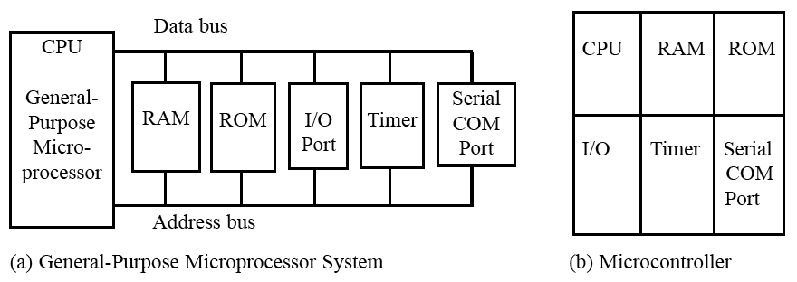
MICROCONTROLLERS AND EMBEDDED PROCESSORS
Microcontroller versus general-purpose microprocessor
Figure 1–1 Microprocessor System Contrasted With Microcontroller System[1]
<number>

Slide 150
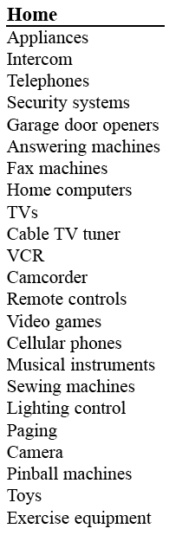
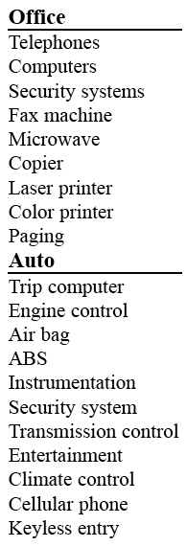
MICROCONTROLLERS AND EMBEDDED PROCESSORS
Microcontrollers for embedded systems
Table 1–1
Some Embedded Products
Using Microcontrollers[1]
<number>

Slide 151
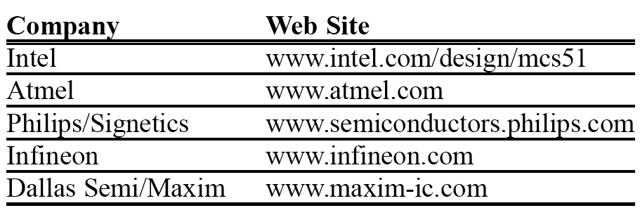
MICROCONTROLLERS AND EMBEDDED PROCESSORS
Choosing a microcontroller
Table:-Various Manufacturers of Microcontrollers
<number>

Slide 152
MICROCONTROLLERS AND EMBEDDED PROCESSORS
CRITERIA FOR CHOOSING A MICROCONTROLLER
Speed
packaging
Power consumption
Amount of RAM/ROM
No. of I/O pins and timer
Upgrade
Cost per unit
<number>

Slide 153
CRITERIA FOR CHOOSING A MICROCONTROLLER
Availability of assembler, compiler.
Availability and reliable sources
<number>

Slide 154
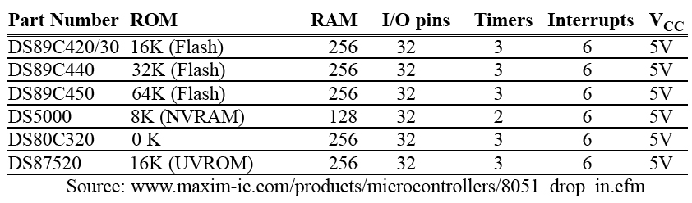
MICROCONTROLLERS AND EMBEDDED PROCESSORS
Table 1–5
Versions of 8051/52 Microcontroller From Dallas Semiconductor (Maxim)
<number>

Slide 155
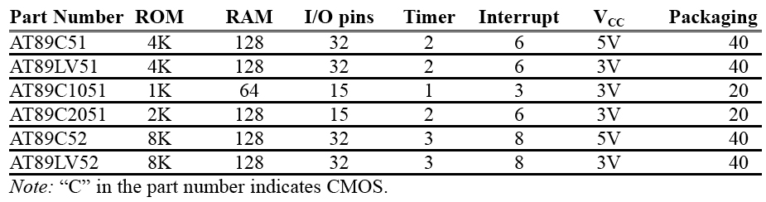
MICROCONTROLLERS AND EMBEDDED PROCESSORS
Table 1–6 Versions of 8051 From Atmel (All ROM Flash)
<number>

Slide 156
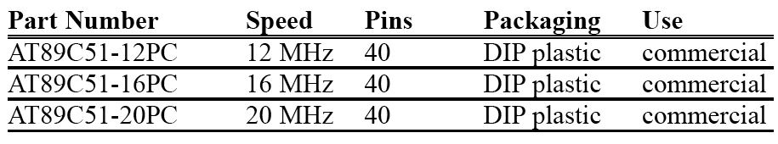
MICROCONTROLLERS AND EMBEDDED PROCESSORS
Table 1–7 Various Speeds of 8051 From Atmel
<number>

Slide 157
A brief history of the 8051
In 1981, Intel Corporation introduced an 8-bit microcontroller called the 8051.
This microcontroller had 128 bytes of RAM, 4K bytes of on-chip ROM, two timers, one serial port, and four ports (each 8-bits wide) all on a single chip.
The 8051 is an 8-bit processor, meaning that the CPU can work on only 8 bits of data at a time.
Data larger than 8 bits has to be broken into 8-bit pieces to be processed by the CPU.
<number>

Slide 158
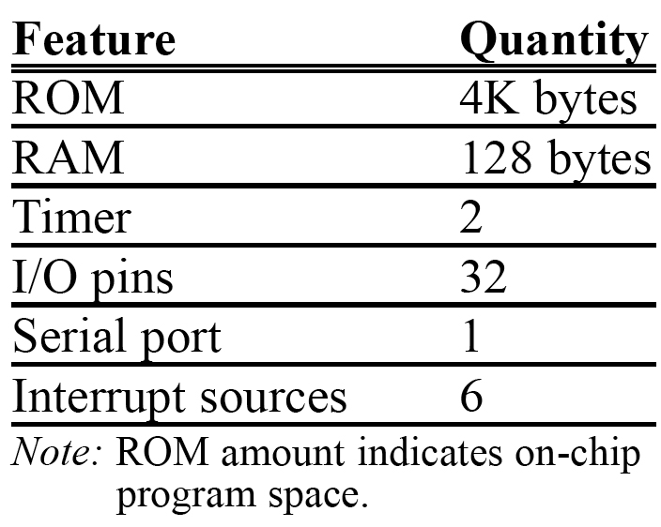
FEATURES OF 8051[1]
<number>

Slide 159
A brief history of the 8051
The 8051 has a total of four I/O ports, each 8 bits wide.
Although the 8051 can have a maximum of 64K bytes of on-chip ROM, many manufacturers have put only 4K bytes on the chip.
The 8051 became widely popular after Intel allowed other manufacturers to make and market any flavors of the 8051 they please with the condition that they remain code-compatible with the 8051.
This has led to many versions of the 8051 with different speeds and amounts of on-chip ROM marketed by more than half a dozen manufacturers.
<number>

Slide 160
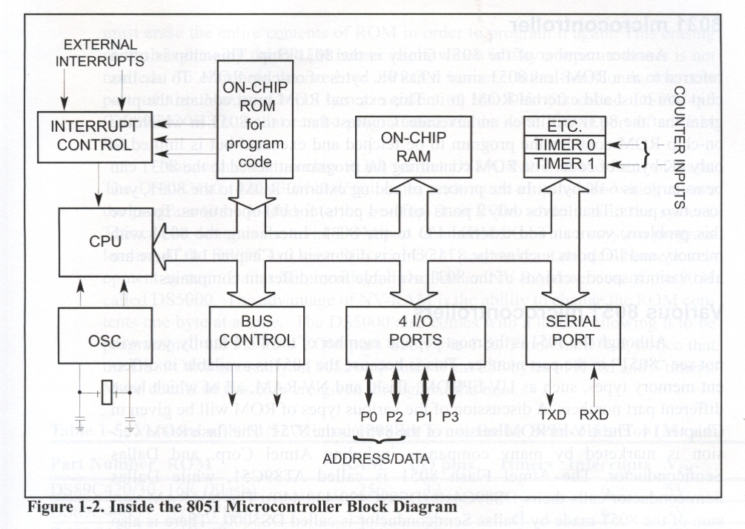
OVERVIEW OF THE 8051 FAMILY[1]
<number>

Slide 161
8052 microcontroller
The 8052 is another member of the 8051 family.
The 8052 has all the standard features of the 8051 as well as an extra 128 bytes of RAM and an extra timer.
8052 has 256 bytes of RAM and 3 timers.
It has 8K bytes of on-chip program ROM instead of 4K bytes.
<number>

Slide 162
8031 microcontroller
This chip is often referred to as a ROM-less 8051 since it has 0K bytes of on-chip ROM.
To use this chip you must add external ROM to it.
This external ROM must contain the program that the 8031 will fetch and execute.
The ROM containing the program attached to the 8031 can be as large as 64K bytes.
In the process of adding external ROM to the 8031, you lose two ports.
To solve this problem, you can add external I/O to the 8031. Interfacing the 8031 with memory and I/O ports such as the 8255 chip is discussed in Chapter 15.
<number>

Slide 163
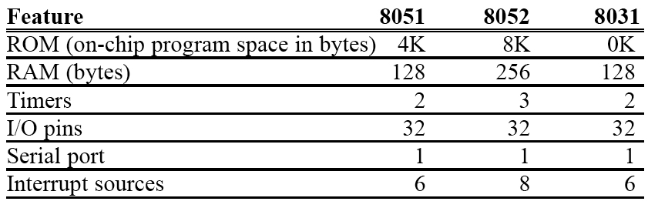
MICROCONTROLLERS AND EMBEDDED PROCESSORS
Table 1–4 Comparison of 8051 Family Members[1]
<number>

Slide 164
Various 8051 microcontrollers
The 8051 is available in different memory types, such as UV-EPROM, flash, and NV-RAM, all of'which have different part numbers.
The UV-EPROM version of the 8051 is the 8751.
The flash ROM version is marketed by many companies including Atmel Corp. and Dallas Semiconductor.
The Atmel Flash 8051 is called AT89C51, while Dallas Semiconductor calls theirs DS89C4xO (DS89C420/430/440).
The NV-RAM version of the 8051 made by Dallas Semiconductor is called DS5000.
There is also an OTP (one-time programmable) version of the 8051 made by various manufacturers.
<number>

Slide 165
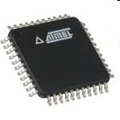

AT89S8253 from Atmel Corporation
We will be using this version of the 8051 in the lab. Each student will be given a chip to program.
Look at the specs of this version at http://www.atmel.com/dyn/resources/prod_documents/doc3286.pdf
<number>

Slide 166

AT89S8253 from Atmel Corporation[3]
<number>

Slide 167
8051 features
The Intel 8051 is a very popular general purpose microcontroller widely used for small scale embedded systems. Many vendors such as Atmel, Philips, and Texas Instruments produce MCS-51 family microcontroller chips.
The 8051 is an 8-bit microcontroller with 8 bit data bus and 16-bit address bus. The 16 bit address bus can address a 64K( 2¹⁶) byte code memory space and a separate 64K byte of data memory space. The 8051 has 4K on-chip read only code memory and 128 bytes of internal Random Access Memory (RAM)
Notes:
<number>
<number>

Slide 168
Features
Besides internal RAM, the 8051 has various Special Function Registers (SFR) such as the Accumulator, the B register, and many other control registers.
34 8-bit general purpose registers in total.
The ALU performs one 8-bit operation at a time.
Two 16 bit /Counter timers
3 internal interrupts (one serial), 2 external interrupts.
4 8-bit I/O ports (3 of them are dual purposed). One of them used for serial port,
Some 8051 chips come with UART for serial communication and ADC for analog to digital conversion.
Notes:
<number>

Slide 169
8051 Chip Pins
40 pins on the 8051 chip.
Most of these pins are used to connect to I/O devices or external data and code memory.
4 I/O port take 32 pins(4 x 8 bits) plus a pair of XTALS pins for crystal clock
A pair of Vcc and GND pins for power supply (the 8051 chip needs +5V 500mA to function properly)
A pair of timer pins for timing controls, a group of pins (EA, ALE, PSEN, WR, RD) for internal and external data and code memory access controls
One Reset pin for reboot purpose
Notes:
<number>
<number>

Slide 170

Pin Diagram of 8051
<number>

Slide 171
The Pin Connection for External Code and Data Memory
Notes:
<number>
<number>

Slide 172
The EA' (External Access) pin is used to control the internal or external memory access.
The signal 0 is for external memory access and signal 1 for internal memory access.
The PSEN' (Program Store Enable) is for reading external code memory when it is low (0) and EA is also 0.
The ALE (Address Latch Enable) activates the port 0 joined with port 2 to provide 16 bit external address bus to access the external memory. The ALE multiplexes the P0:
1 for latching address on P0 as A0-A7 in the 16 bit address buss, 0 for latching P0 as data I/O.
P0.x is named ADx because P0 is multiplexed for Address bus and Data bus at different clock time.
WR' only provides the signal to write external data memory
RD' provides the signal to read external data and code memory.
Notes:
<number>

Slide 173
System Clock and Oscillator Circuits
The 8051 requires an external oscillator circuit. The oscillator circuit usually runs around 12MHz. the crystal generates 12M pulses in one second. The pulse is used to synchronize the system operation in a controlled pace..
A machine cycle is minimum amount time a simplest machine instruction must take
An 8051 machine cycle consists of 12 crystal pulses (clock cycle).
instruction with a memory operand so that it needs multiple memory accesses.
Notes:
<number>
<number>

Slide 174
Contd.
The first 6 crystal pulses (clock cycle) is used to fetch the opcode and the second 6 pulses are used to perform the operation on the operands in the ALU. This gives an effective machine cycle rate at 1MIPS (Million Instructions Per Second).
Crystal to 8051 XTAL 1/2
Notes:
<number>

Slide 175
The Port Alternate Functions
PORT P1 (Pins 1 to 8): The port P1 is a port dedicated for general I/O purpose. The other ports P0, P2 and P3 have dual roles in addition to their basic I/O function.
PORT P0 (pins 32 to 39): When the external memory access is required then Port P0 is multiplexed for address bus and data bus that can be used to access external memory in conjunction with port P2. P0 acts as A0-A7 in address bus and D0-D7 for port data. It can be used for general purpose I/O if no external memory presents.
PORT P2 (pins 21 to 28): Similar to P0, the port P2 can also play a role (A8-A15) in the address bus in conjunction with PORT P0 to access external memory.
Notes:
<number>
<number>

Slide 176
Contd.
PORT P3 (Pins 10 to 17):
In addition to acting as a normal I/O port,
P3.0 can be used for serial receive input pin(RXD)
P3.1 can be used for serial transmit output pin(TXD) in a serial port,
P3.2 and P3.3 can be used as external interrupt pins(INT0’ and INT1’),
P3.4 and P3.5 are used for counter input pins(T0 and T1),
P3.6 and P3.7 can be used as external data memory write and read control signal pins(WR’ and RD’)read and write pins for memory access.
Notes:
<number>
<number>

Slide 177
8051 Internal Architecture
The CPU is the heart of any computer which is in charge of computer operations.
The CPU has many important registers.
The Program Count (PC) always holds the code memory location of next instruction.
It fetches instructions from the code memory into the instruction Register (IR), analyzes the opcode of the instruction, updates the PC to the location of next instruction, fetches the operand from the data memory if necessary, and finally performs the operation in the Arithmetic-Logic Unit (ALU) within the CPU.
Notes:
<number>
<number>

Slide 178
Contd.
The B register is a register just for multiplication and division operation which requires more register spaces for the product of multiplication and the quotient and the remainder for the division.
The immediate result is stored in the accumulator register (Acc) for next operation
The Program Status Word (PSW) is updated depending on the status of the operation result.
Notes:
<number>
<number>

Slide 179

<number>

Slide 180
8051 Internal Architecture
Notes:
<number>

Slide 181
Ports Port Reading and Writing
There are 4 8-bit ports: P0, P1, P2 and P3. All of them are dual purpose ports except P1 which is only used for I/O. The following diagram shows a single bit in an 8051 I/O port.
Single Bit In I/O Port
Notes:
<number>
<number>

Slide 182
Contd.
When a C program writes a one byte value to a port or a single bit value to a bit of a port, just simply assign the value to the port as follows:
P1 ; or P1.2=1;
P1 represents the 8 bits of port 1 and P1.2 is the pin #2 of the port 1 of 8051 defined in the reg51.h of C51, a C dedicated for 8051 family.
Notes:
<number>
<number>

Slide 183

Port 0
Can be used as input or output.
Each pin must be connected to a 10 K-ohm pull up resistor.
<number>

Slide 184
Contd.
Port 0 as input
Port 0 can be configured first as an input port by writing 1 to all the bits.
MOV A,#0FFH;
MOV P0, A;
Port1
Can be used as input or output.
Donot need any pull up resistors
Upon RESET ,Port 1 is configured as an input port.
Notes:
<number>

Slide 185

Single bit instruction.
<number>

Slide 186
Memory and SFR
The 8051 code(program) memory is read-only, while the data memory is read/write accessible. The program memory( in EPROM) can be rewritten by the special programmer circuit.
The 8051 memory is organized in a Harvard Architecture. Both the code memory space and data memory space begin at location 0x00 for internal or external memory which is different from the Princeton Architecture where code and data share same memory space.
The advantage of the Harvard Architecture is not only doubling the memory capacity of the microcontroller with same number of address lines but also increases the reliability of the microcontroller, since there are no instructions to write to the code memory which is read only.
Notes:
<number>

Slide 187
Separate read instructions for external data and code memory.
Notes:
<number>
<number>

Slide 188
Contd.
The 8051 has 256 bytes of internal addressable RAM, although only first 128 bytes are available for general use by the programmer.
The first 128 bytes of RAM (from 0x00 to 0x7F) are called the direct memory, and can be used to store data.
The lowest 32 bytes of RAM are reserved for 4 general register banks. The 8051 has 4 selectable banks of 8 addressable 8-bit registers, R0 to R7.

Slide 189
Contd.
This means that there are essentially 32 available general purpose registers, although only 8 (one bank) can be directly accessed at a time.
The advantage of using these register banks is time saving on the context switch for interrupted program to store and recover the status.
Otherwise the push and pop stack operations are needed to save the current state and to recover it after the interrupt is over.
The default bank is bank 0.
The second 128 bytes are used to store Special Function Registers (SFR) that C51 program can configure and control the ports, timer, interrupts, serial communication, and other tasks.
Notes:
<number>
<number>

Slide 190
Special Function Registers (SFRs)
The SFR is the upper area of addressable memory, from address 0x80 to 0xFF. This area consists of a series of memory-mapped ports and registers.
All port input and output can therefore be performed by get and set operations on SFR port name such as P3.
Also, different status registers are mapped into the SFR for checking the status of the 8051, and changing some operational parameters of the 8051.
All 8051 CPU registers, I/O ports, timers and other architecture components are accessible in 8051 C through SFRs
They are accessed in normal internal RAM (080H – 0FFH) by 8051 C, and they all are defined in the header file reg51.h listed below.
Notes:
<number>

Slide 191
Contd.
There are 21 SFRs.
In addition to I/O ports, the most frequently used SFRs to control and configure 8051 operations are:
TCON (Timer CONtrol)
TMOD (Timer MODe)
TH0/TH1 and TL0/TL1 (Timer’s high and low bytes)
SCON (Serial port CONtrol)
IP (Interrupt Priority)
IE ( Interrupt Enable)
Almost all 8051 C embedded programs include the reg51.h.
Notes:
<number>

Slide 192
The sbit register variables of these SFRs defined in reg51.h often used in embedded C program.
1. TCON (Timer/Counter Control Register) SFR for timer control
TF0/TF1: Timer0/1 overflow flag is set when the timer counter overflows, reset by program
TR0/TR1: Timer0/1 run control bit is set to start, reset to stop the timer0/1
IE0/IE1: External interrupt 0/1 edge detected flag1 is set when a falling edge interrupt on the external port 0/1, reset(cleared) by hardware itself for falling edge transition-activated INT; Reset by code for low level INT.
IT0/IT1 External interrupt type (1: falling edge triggered, 0 low level triggered)
bit 7 | bit 6 | bit 5 | bit 4 | bit 3 | bit 2 | bit 1 | bit 0 (88H)
TF1 | TR1 | TF0 | TR0 | IE1 | IT1 | IE0 | IT0
Notes:
<number>
<number>

Slide 193
IE (Interrupt Enable Register) SFR used for interrupt control
bit 7 | bit 6 | bit 5 | bit 4 | bit 3 | bit 2 | bit 1 | bit 0 (A8H)
EA |  | ET2 | ES | ET1 | EX1 | ET0 | EX0
Notes:
<number>

Slide 194
PSW (Program Status Word) SFR for CPU status
P: parity check flag
OV: ALU overflow flag
RS0/RS1: Register bank specification mode
00: bank 0 (00H-07H); 01: bank1; 10: bank 2; 11: bank 3(18H-1FH)
F0: User defined lag
CY: ALU carry out
AC: ALU auxiliary carry out
bit 7 | bit 6 | bit 5 | bit 4 | bit 3 | bit 2 | bit 1 | bit 0
CY | AC | F0 | RS1 | RS0 | OV |  | P

Slide 195
P3( Port 3) SFR used for I/O and other special purposes
Addition to I/O usage, P3 can also be used for:
RXD/TXD: Receive/Transmit serial data for RS232
INT0, INT1: External interrupt port inputs
T0,T1: Alternative Timer 0/1 bit
WR/RD : Write/Read control bits used for external memory
If external RAM or EPROM is used, ports P0 and P2 are used to address the external memory.
Other port SFRs such as P0, P1, P2 are mainly used for data I/O.
bit 7 | bit 6 | bit 5 | bit 4 | bit 3 | bit 2 | bit 1 | bit 0
RD | WR | T1 | T0 | INT1 | INT0 | TxD | RxD
Notes:
<number>

Slide 196
6. TL0/TL1 SFRs: Lower byte of Timer 0/1, used to set timer interrupt period
TH0/TH1 SFRs: Higher byte of Timer 0,used to set timer interrupt period
7. TMOD ( Timer Mode Register)
Note: bit 0-3 for Timer0 and bit 4-7 for Timer1
bit 7 | bit 6 | bit 5 | bit 4 | bit 3 | bit 2 | bit 1 | bit 0
Gate | C/T | M1 | M0 | Gate | C/T | M1 | M0
Notes:
<number>

Slide 197
Working as a “Timer”, the timer is incremented by one every machine cycle. A machine cycle consists of 12 oscillator periods, so the count rate is 1/12 of the oscillator frequency.
Working as a “Counter”, the counter is incremented in response to a falling edge transition in the external input pins.
The external input is sampled once every machine cycle. A “high” sample followed by a low sample is counted once.
Timer 0 and Timer 1 have four operating modes.
M1, M0 Mode Control
0 0 (Mode 0) 13 bit count mode
0 1 (Mode 1) 16 bit count mode
1 0 (Mode 2) Auto reload mode
1 1 (Mode 3) Multiple mode
Notes:
<number>

Slide 198
8051 data type and directives
The 8051 microcontroller has only one data type. It is 8 bits, and the size of each register is also 8 bits.
It is the job of the programmer to break down data larger than 8 bits (00 to FFH, or 0 to 255 in decimal) to be processed by the CPU. For examples of how to process data larger than 8 bits.
The data types used by the 8051 can be positive or negative.
Notes:
<number>

Slide 199
DB (define byte)
The DB directive is the most widely used data directive in the assembler. It is used to define the 8-bit data. When DB is used to define data, the numbers can be in decimal, binary, hex, or ASCII formats. For decimal, the “D” after the decimal number is optional, but using “B” (binary) and “H” (hexadecimal) for the others is required.
Regardless of which is used, the assembler will convert the numbers into hex. To indicate ASCII, simply place the characters in quotation marks (‘like this’). The assembler will assign the ASCII code for the numbers or characters automatically. The DB directive is the only directive that can be used to define ASCII strings larger than two characters; therefore, it should be used for all ASCII data definitions.
<number>

Slide 200

DB examples
<number>

Slide 201
ORG (origin)
The ORG directive is used to indicate the beginning of the address. The number that comes after ORG can be either in hex or in decimal. If the number is not followed by H, it is decimal and the assembler will convert it to hex. Some assemblers use “. ORG” (notice the dot) instead of “ORG” for the origin directive. Check your assembler.
<number>

Slide 202

EQU (equate)
This is used to define a constant without occupying a memory location. The EQU directive does not set aside storage for a data item but associates a constant value with a data label so that when the label appears in the program, itp constant value will be substituted for the label. The following uses EQU for the counter constant and then the constant is used to load the R3 register.
<number>

Slide 203
END directive
Another important pseudocode is the END directive. This indicates to the assembler the end of the source (asm) file. The END directive is the last line of an 8051 program, meaning that in the source code anything after the END directive is ignored by the assembler. Some assemblers use “. END” (notice the dot) instead of “END”.
<number>

Slide 204
Rules for labels in Assembly language
By choosing label names that are meaningful, a programmer can make a program much easier to read and maintain. There are several rules that names must follow. First, each label name must be unique. The names used for labels in Assembly language programming consist of alphabetic letters in both uppercase and lowercase, the digits 0 through 9, and the special characters question mark (?), period (.), at (@), underline (_), and dollar sign ($). The first character of the label must be an alphabetic character.
In other words it cannot be a number. Every assembler has some reserved words that must not be used as labels in the program. Foremost among the reserved words are the mnemonics for the instructions. For example, “MOV” and “ADD” are reserved since they are instruction mnemonics. In addition to the mnemonics there are some other reserved words. Check your assembler for the list of reserved words.
<number>

Slide 205
What is an addressing mode
?
Addressing mode is a way to address an operand.
In other words, access data are modes.
various ways to called addressing
Operand means the data we are operating upon (in most cases source data).
It can be a direct address of memory, it can be register names, it can be any numerical data etc.

Slide 206
Addressing Modes
8051 provides a total of five distinct addressing modes.
1. Immediate
2.Register
3.Direct
4. Register indirect
5. Indexed

Slide 207
Immediate Addressing Modes
If the operand is a constant then it can be stored in memory immediately after the opcode.
immediate addressing is only of use when the data to be read is a constant
if your program needed to perform some calculations based on the number of weeks in the year, you could use immediate addressing to load the number 52 (34H) into a register and then perform arithmetic operations upon this data
MOV R0, #34H (2byte instruction)

Slide 208
Immediate Addressing
The above instruction is an example of immediate addressing. It moves the data 34H into R0
The assembler must be able to tell the difference between an address and a piece of data
The has symbol (#) is used for this purpose (whenever the assembler sees # before a number it knows this is immediate addressing)

Slide 209
Register Addressing
Often we need to move data from a register into the accumulator so that we can perform arithmetic operations upon it
For example, we may wish to move the contents of R5 into the accumulator.
MOV A, R5
This is an example of register addressing. It moves data from R5 (in the currently selected register bank) into the accumulator.
Another example, ADD A, R6

Slide 210
Direct Addressing
Direct addressing is used for accessing data in the on-chip RAM
MOV R0, 40H; save content of RAM
;location 40h in R0
MOV 56H,A; save content of A in RAM
;location 56H

Slide 211

Direct Addressing
Examples
MOV A,4
MOV A,R4 into ;A
; is same as
; which means copy R4
Applicable only for RB0 registers; since RAM location are 0 to 7 for R0 to R7 respectively of Register bank 0.

Slide 212

Register Indirect
Register addressing and direct addressing both restrict the programmer to manipulation of data in fixed addresses
The address the instruction reads from (MOV A, 30H) or writes to (MOV 30H,
cannot be altered while the
program is running.
There are times when it is necessary to read and write to a number of contiguous memory locations.

Slide 213
Register Indirect
For example, if you had an array of 8-bit numbers stored in memory, starting at address 30H, you may wish to examine the contents of each number in the array (perhaps to find the smallest number)
To do so, you would need to read location 30H, then 31H, then 32H and so on.

Slide 214
Register Indirect
This can be achieved using indirect addressing
R0 and R1 may be used as pointer registers
MOV A, @Ri
where Ri is either R0 or R1

Slide 215
Register Indirect
Now, we can read the contents of location 30H through indirect addressing
MOV R0, #30H MOV A, @R0
The first instruction is an example of immediate addressing whereby the data 30H is placed in R0
The second instruction is indirect addressing. It moves the contents of location 30H into the accumulator.

Slide 216
Register Indirect
If we now wish to get the data in location 31H we use the following:
INC R0
MOV A, @R0
This is just like the Pointers in C.

Slide 217

Indexed
Indexed addressing modes is widely used in accessing data elements of look up table entries located in the program ROM space of 8051.
The instruction used for this purpose is
MOVC A,@A+DPTR.
The 16-bit register DPTR and reg A are used to form the address of data element stored in on-chip ROM.

Slide 218
Indexed
Because the data elements are stored in the pragram(code) memory.
Instruction MOVC is used instead of MOV
C is for Code i.e. move data from code memory

Slide 219
Data Transfer instructions
Mnemonics | Operational description | Addressing mode | No. of bytes occupied
Mov a,#num | Copy the immediate data num in to acc | immediate | 2 ,1
Mov Rx,a | Copy the data from acc to Rx | register | 1,1
Mov a,Rx | Copy the data from Rx to acc | register | 1,1
Mov Rx,#num | Copy the immediate data num in to Rx | immediate | 2,1
Mov a,add | Copy the data from direct address add to acc | direct | 2,1
Mov add,a | Copy the data from acc to direct address add | direct | 2,1
Mov add,#num | Copy the immediate data num in to direct address | direct | 3,2
Mov add1,add2 | Copy the data from add2 to add1 | direct | 3,2
Mov Rx,add | Copy the data from direct address add to Rx | direct | 2,2
Mov add,Rx | Copy the data from Rx to direct address add | direct | 2,2
Mov @Rp,a | Copy the data in acc to address in Rp | Indirect | 1,1
Mov a,@Rp | Copy the data that is at address in Rp to acc | Indirect | 1,1

Slide 220
Data Transfer instructions
Mnemonics | Operational description | Addressing mode | No. of bytes occupied
Mov @Rp,#num | Copy the immediate byte num to the address in Rp | Indirect | 2
Movx a,@Rp | Copy the content of external add in Rp to acc | Indirect | 1
Movx a,@DPTR | Copy the content of external add in DPTR to acc | Indirect | 1
Movx @Rp,a | Copy the content of acc to the external add in Rp | Indirect | 1
Movx @DPTR,a | Copy the content of acc to the external add in DPTR | Indirect | 1
Movc a,@a+DPTR | The address is formed by adding acc and DPTR and its content is copied to acc | indirect | 1
Movc a, @a+PC | The address is formed by adding acc and PC and its content is copied to acc | indirect | 1
Push add | Increment SP and copy the data from source add to internal RAM address contained in SP | Direct | 2
Pop add | copy the data from internal RAM address contained in SP to destination add and decrement SP | direct | 2
Xch a, Rx | Exchange the data between acc and Rx | Register | 1
Xch a, add | Exchange the data between acc and given add | Direct | 2
Xch a,@Rp | Exchange the data between acc and address in Rp | Indirect | 1
Xchd a, @Rp | Exchange only lower nibble of acc and address in Rp | indirect | 1

Slide 221
Logical Instructions
Mnemonics | Operational description | Addressing mode | No. of bytes occupied | No. of cycles used
Anl a, #num | AND each bit of acc with same bit of immediate num, stores result in acc | Immediate | 2 | 1
Anl a, add | AND each bit of acc with same bit of content in add, stores result in acc | Direct | 2 | 1
Anl a, Rx | AND each bit of acc with same bit of content of Rx, stores result in acc | Register | 1 | 1
Anl a, @Rp | AND each bit of acc with same bit of content of add given by Rp, stores result in acc | Indirect | 1 | 1
Anl add, a | AND each bit of acc with same bit of direct add num, stores result in add | Direct | 2 | 1
Anl add, #num | AND each bit of direct add with same bit of immediate num, stores result in add | direct | 3 | 2
orl a, #num | OR each bit of acc with same bit of immediate num, stores result in acc | Immediate | 2 | 1
orl a, add | OR each bit of acc with same bit of content in add, stores result in acc | Direct | 2 | 1
orl a, Rx | OR each bit of acc with same bit of content of Rx, stores result in acc | Register | 1 | 1
orl a, @Rp | OR each bit of acc with same bit of content of add given by Rp, stores result in acc | Indirect | 1 | 1
orl add, a | OR each bit of acc with same bit of direct add num, stores result in add | Direct | 2 | 1
orl add, #num | OR each bit of direct add with same bit of immediate num, stores result in add | direct | 3 | 2
Xrl a, #num | XOR each bit of acc with same bit of immediate num, stores result in acc | Immediate | 2 | 1

Slide 222
Logical Instructions
Mnemonics | Operational description | Addressing mode | No. of bytes occupied
Xrl a, add | XOR each bit of acc with same bit of content in add, stores result in acc | Direct | 2
Xrl a, Rx | XOR each bit of acc with same bit of content of Rx, stores result in acc | Register | 1
Xrl a, @Rp | XOR each bit of acc with same bit of content of add given by Rp, stores result in acc | Indirect | 1
Xrl add, a | XOR each bit of acc with same bit of direct add num, stores result in add | Direct | 2
Xrl add, #num | XOR each bit of direct add with same bit of immediate num, stores result in add | direct | 3
Clr a | Clear each bit of acc | Direct | 1
Cpl a | Complement each bit of acc | direct | 1
Anl c, b | AND carry with given bit b, stores result in carry | — | 2
Anl c, /b | AND carry with complement of given bit b, stores result in carry | — | 2
Orl c, b | OR carry with given bit b, stores result in carry | — | 2

Slide 223
Logical Instructions
Mnemonics | Operational description | Addressing mode | No. of bytes occupied
Orl c, /b | OR carry with complement of given bit b, stores result in carry | — | 2
Cpl c | Complement carry flag | — | 1
Cpl b | Complement bit b | — | 2
Clr c | Clear carry flag | — | 1
Clr b | Clear given bit b | — | 2
Mov c, b | Copy bit b to carry | — | 2
Mov b, c | Copy carry to bit b | — | 2
Setb c | Set carry flag | — | 1
Setb b | Set bit b | — | 2
Rl a | Rotate acc one bit left | — | 1
Rr a | Rotate acc one bit right | — | 1
Rlc a | Rotate acc one bit left with carry | — | 1
Rrc a | Rotate acc one bit right with carry | — | 1
Swap a | Exchange upper and lower nibble of acc | — | 1

Slide 224
Arithmetic Instructions
Mnemonics | Operational description | Addressing mode | No. of bytes occupied
Inc a | Add 1 to acc | Register | 1
Inc Rr | Add 1 to register Rr | Register | 1
Inc add | Add 1 to the content of add | Direct | 2
Inc @rp | Add 1 to the content of the address in Rp | indirect | 1
Inc DPTR | Add 1 to DPTR | Register | 1
dec a | Subtract 1 from acc | Register | 1
dec Rr | Subtract 1 from Rr | Register | 1
dec add | Subtract 1 from content of add | Direct | 2
dec @rp | Subtract 1 from the content of address | indirect | 1
Add a, #num | Add the immediate num with acc and stores result in acc | immediate | 2
Add a, Rx | Add the data in Rx with acc and stores result in acc | Register | 1
Add a, add | Add the data in add with acc and stores result in acc | Direct | 2
Add a, @Rp | Add the data at the address in Rp with acc and stores result in acc | Indirect | 1
Addc a,#num | Add the immediate num with acc and carry, stores result in acc | immediate | 2
Addc a, Rx | Add the data in Rx with acc and carry, stores result in acc | Register | 1

Slide 225
Arithmetic Instructions
Mnemonics | Operational description | Addressing mode | No. of bytes occupied
Addc a, add | Add the data in add with acc and carry, stores result in acc | Direct | 2
Addc a, @Rp | Add the data at the address in Rp with acc and carry, stores result in acc | Indirect | 1
Subb a, #num | Subtract immediate num and carry from acc; stores the result in acc | immediate | 2
Subb a, add | Subtract the content of add and carry from acc; stores the result in acc | Register | 1
Subb a, Rx | Subtract the data in Rx and carry from acc; stores the result in acc | Direct | 2
Subb a, @Rp | Subtract the data at the address in Rp and carry from acc; stores the result in acc | Indirect | 1
Mul ab | Multiply acc and register B. store the lower byte of result in acc and higher byte in B | — | 1
div ab | divide acc by register B. store quotient in acc and remainder in B | — | 1
Da a | After addition of two packed BCD numbers, adjust the sum to decimal format | — | 1

Slide 226
Branching Instructions
Mnemonic | Operational description | No of bytes occupied
Jc label | Jump to label if carry is set to 1 | 2
Jnc label | Jump to label if carry is cleared to 0 | 2
Jb b,label | Jump to label if given bit is set to 1 | 3
Jnb b,label | Jump to label if given bit is cleared to 0 | 3
Jbc b,label | Jump to label if given bit is set. Clear the bit | 3
Cjne a, add, label | Compare the content of accumulator with the content of given address and if not equal jump to label | 3
Cjne a, #num, label | Compare the content of accumulator with immediate number and if not equal jump to label | 3
Cjne Rx, #num, label | Compare the content of Rx with the immediate number and if not equal jump to label | 3
Cjne @Rp, #num, label | Compare the content of location in Rp with immediate number and if not equal jump to label | 3
Djnz Rx, label | Decrement the content of Rx and jump to the label if it is not zero | 2
Djnz add, label | Decrement the content of address and jump to the label if it is not zero | 3

Slide 227
Branching Instructions
Mnemonic | Operational description | No of bytes occupied
Jz label | Jump to the label if content of accumulator is 0 | 2
Jnz label | Jump to the label if content of accumulator is not 0 | 2
Jmp @a+dptr | Jump to the address created by adding the contents on accumulator and dptr | 1
Ajmp sadd | Take a jump to absolute short range address sadd | 2
Ljmp ladd | Take a jump to absolute long range address sadd | 3
Sjmp radd | Take a jump to relative address radd | 2
nop | Short form of no operation means do nothing and go to next instruction | 1
Acall sadd | Pushes the content of Acc on stack and load it will absolute short range address sadd | 2
Lcall ladd | Pushes the content of Acc on stack and load it will absolute long range address sadd | 3
Ret | returns from subroutine by restoring the Acc from stack using pop operation | 1
reti | Returns from interrupt subroutine by restoring Acc from stack using pop operation | 1

Slide 228

AVR
Microcontroller: Microcontroller can be termed as a single on chip computer which includes number of peripherals like RAM, EEPROM, Timers etc., required to perform some predefined task.

Slide 229
History of AVR
AVR was developed in the year 1996 by Atmel Corporation.
The architecture of AVR was developed by Alf-Egil Bogen and Vegard Wollan. AVR derives its name from its developers and stands for Alf-Egil Bogen Vegard Wollan RISC microcontroller, also known as Advanced Virtual RISC.
The AT90S8515 was the first microcontroller which was based on AVR architecture however the first microcontroller to hit the commercial market was AT90S1200 in the year 1997.

Slide 230
AVR Microcontrollers
There are variety of AVR microcontrollers all are 8 bit controller except AVR32.
One problem with AVR microcontrollers is that they are not 100% compatible in terms of software when going from one family to another.

Slide 231
AVR Microcontrollers
AVR microcontrollers are available in three categories:
1. TinyAVR – Less memory, small size, suitable only for simpler applications
2. MegaAVR – These are the most popular ones having good amount of memory (upto 256 KB), higher number of inbuilt peripherals and suitable for moderate to complex applications.
3. XmegaAVR – Used commercially for complex applications, which require large program memory and high speed.

Slide 232
AVR Microcontrollers
AVR is an 8-bit microcontroller belonging to the family of Reduced Instruction Set Computer (RISC). In RISC architecture the instruction set of the computer are not only fewer in number but also simpler and faster in operation.
This means that the microcontroller is capable of transmitting and receiving 8-bit data. The input/output registers available are of 8-bits. The AVR family controllers have register based architecture which means that both the operands for an operation are stored in a register and the result of the operation is also stored in a register.

Slide 233
AVR Microcontrollers
Atmega16 microcontroller, which is a 40-pin IC and belongs to the megaAVR category of AVR family. Some of the features of Atmega16 are:
· 16KB of Flash memory
· 1KB of SRAM
· 512 Bytes of EEPROM
· Available in 40-Pin DIP
· 8-Channel 10-bit ADC
· Two 8-bit Timers/Counters
· One 16-bit Timer/Counter
· 4 PWM Channels
· In System Programmer (ISP)
· Serial USART
· SPI Interface
· Digital to Analog Comparator.

Slide 234
Atmega16 Microcontroller
Architecture of these microcontrollers are based on the advanced RISC architecture and consist of 32 x 8-bit general purpose working registers.
Follows Harvard Architecture format in which the processor is equipped with separate memories and buses for Program and the Data information.
Since AVR can perform single cycle execution, it means that AVR can execute 1 million instructions per second if cycle frequency is 1MHz. The higher is the operating frequency of the controller, the higher will be its processing speed. We need to optimize the power consumption with processing speed and hence need to select the operating frequency accordingly.

Slide 235

Atmega16 Microcontroller
There are two flavors for Atmega16 microcontroller:
1. Atmega16:- Operating frequency range is 0 – 16 MHz.
2. Atmega16L:- Operating frequency range is 0 – 8 MHz.
The AT refers to Atmel the manufacturer, Mega means that the microcontroller belong to MegaAVR category, 16 signifies the memory of the controller, which is 16KB.

Slide 236

Atmega16 Architecture

Slide 237
Atmega16 Architecture
I/O Ports: Atmega16 has four (PORTA, PORTB, PORTC and PORTD) 8-bit input-output ports.
Internal Calibrated Oscillator: Atmega16 is equipped with an internal oscillator for driving its clock. By default Atmega16 is set to operate at internal calibrated oscillator of 1 MHz. The maximum frequency of internal oscillator is 8Mhz. Alternatively, ATmega16 can be operated using an external crystal oscillator with a maximum frequency of 16MHz.
ADC Interface: Atmega16 is equipped with an 8 channel ADC (Analog to Digital Converter) with a resolution of 10-bits. ADC reads the analog input for e.g., a sensor input and converts it into digital information which is understandable by the microcontroller.
Timers/Counters: Atmega16 consists of two 8-bit and one 16-bit timer/counter. Timers are useful for generating precision actions for e.g., creating time delays between two operations.

Slide 238
Atmega16 Architecture
Watchdog Timer: Watchdog timer is present with internal oscillator. Watchdog timer continuously monitors and resets the controller if the code gets stuck at any execution action for more than a defined time interval.
Interrupts: Atmega16 consists of 21 interrupt sources out of which four are external. The remaining are internal interrupts which support the peripherals like USART, ADC, Timers etc.
USART: Universal Synchronous and Asynchronous Receiver and Transmitter interface is available for interfacing with external device capable of communicating serially (data transmission bit by bit).

Slide 239
Atmega16 Architecture
General Purpose Registers: Atmega16 is equipped with 32 general purpose registers which are coupled directly with the Arithmetic Logical Unit (ALU) of CPU.
Memory: Atmega16 consist of three different memory sections:
1. Flash EEPROM: Flash EEPROM or simply flash memory is used to store the program dumped or burnt by the user on to the microcontroller. It can be easily erased electrically as a single unit. Flash memory is non-volatile i.e., it retains the program even if the power is cut-off. Atmega16 is available with 16KB of in system programmable Flash EEPROM.
2. Byte Addressable EEPROM: This is also a nonvolatile memory used to store data like values of certain variables. Atmega16 has 512 bytes of EEPROM.
3. SRAM: Static Random Access Memory, this is the volatile memory of microcontroller i.e., data is lost as soon as power is turned off. Atmega16 is equipped with 1KB of internal SRAM. A small portion of SRAM is set aside for general purpose registers used by CPU and some for the peripheral subsystems of the microcontroller.

Slide 240
Atmega16 Architecture
ISP: AVR family of controllers have In System Programmable Flash Memory which can be programmed without removing the IC from the circuit, ISP allows to reprogram the controller while it is in the application circuit.
DAC: Atmega16 is also equipped with a Digital to Analog Converter (DAC) interface which can be used for reverse action performed by ADC. DAC can be used when there is a need of converting a digital signal to analog signal.

Slide 241
Atmega16 Architecture
MegaAVR Family
Various microcontroller of MegaAVR series:
ATmega8 and Atmega32 are other members of MegaAVR series controllers. They are quite similar to ATmega16 in architecture. Low power version MegaAVR controllers are also available in markets. The following table shows the comparison between different members of MegaAVR family:
Part Name ROM RAM EEPROM I/0 Pins Timer Interrupts OperationVoltage Operating frequency Packaging
ATmega8 8KB 1KB 512B 23 3 19 4.5-5.5 V 0-16 MHz 28
ATmega8L 8KB 1KB 512B 23 3 19 2.7-5.5 V 0-8 MHz 28
ATmega16 16KB 1KB 512B 32 3 21 4.5-5.5 V 0-16 MHz 40
ATmega16L 16KB 1KB 512B 32 3 21 2.7-5.5 V 0-8 MHz 40
ATmega32 32KB 2KB 1KB 32 3 21 4.5-5.5 V 0-16 MHz 40
ATmega32L 32KB 2KB 1KB 32 3 21 2.7-5.5 V 0-8 MHz 40

Slide 242
AVR Microcontrollers
AVR Registers:
AVR is 8 bit microcontroller therefore all its ports are 8 bit wide. Every port has 3 registers associated with it each one have size of 8 bits. Every bit in those registers configures the pins of particular port. Bit0 of these registers are associated with Pin0 of the port, Bit1 of these registers are associated with Pin1 of the port, and same as for other bits.
The three registers available in AVR microcontroller are as follows:
DDRx register
PORTx register
PINx register

Slide 243
AVR Microcontrollers
DDRx register:
Data Direction Register configures the data direction of port pins. These registers are used for determining whether port pins will be used for input or output. On writing 1 to a bit in DDRx makes corresponding port pin as output, while writing 0 to a bit in DDRx makes corresponding port pin as input.
For example:
For making all pins of port A as output pins:
DDRA= 0b11111111;
For making all pins of port A as input pins:
DDRA= 0b00000000;
For making lower nibble of port B as output and higher nibble as input:
DDRB=0b00001111;

Slide 244
AVR Microcontrollers
PORTx register:
In general PORTx register can be used for two purposes:
To output data: when port is configured as output then PORTx register is used. When we set bits in DDRx to 1, corresponding pins becomes output pins. Now we can write the data into respective bits in PORTx register. This will immediately change the output state of pins according to data we have written on the ports.
PINx register:
PINx register used to read the data from port pins. In order to read the data from port pin, first we have to change the ports data direction to input. This is done by setting bits in DDRx to zero. If port is made output, then reading PINx register will give a data that has been output on port pins.
There are two input modes. Either we can use port pins as internal pull up or as tri stated inputs. It will be explained as shown below:
For reading the data from port A,
DDRA = 0x00; //Set port A as input
x = PINA; //Read contents of port a

Slide 245
AVR Microcontrollers
AVR Memory:
AVR microcontrollers are built using a modified Harvard Architecture. This means the Flash Program Memory space is on a separate address bus than the Static Random Access Memory (SRAM). There are two data bus, one that can access all data and the In/Out data bus with limited access to a small section of memory.

Slide 246

AVR Microcontrollers

Slide 247
AVR Microcontrollers
AVR Memory Program Memory
The AVR microcontrollers contain On-chip In-System Reprogrammable Flash memory for program storage. Since all AVR instructions are 16 or 32 bits wide, the Flash is organized as 32K x 16. For software security, the Flash Program memory space is divided into two sections - Boot Loader Section and Application Program Section in the device. The Flash memory has a typical endurance of at least 10,000 write/erase cycles. Constant tables can be allocated within the entire program memory address space, using the Load Program Memory (LPM) instruction.

Slide 248

AVR Microcontrollers

Slide 249
AVR Microcontrollers
EEPROM Data Memory
Data electrically erasable programmable read-only memory (EEPROM) is organized as a separate data space, in which single bytes can be read and written. Access from the CPU to EEPROM is done through the EEPROM Address Registers, the EEPROM Data Register, and the EEPROM Control Register. The EEPROM has an endurance of at least 100,000 write/erase cycles.
SRAM Data Memory
Data can be accessed through the standard data bus. There is a secondary In/Out bus for rapid direct access to select locations.
Data memory consists of :
Registers
I/O Memory
Extended I/O Memory (Device dependent)
Internal SRAM

Slide 250

AVR Microcontrollers
Register space - consists of 32 general purpose working 8-bit registers (R0-R31).
I/O Memory - contains addressable space for peripheral functions, such as control registers and other I/O functions.
Extended I/O Memory - Some AVR microcontrollers with more peripherals need more space than the I/O memory can address so some of the SRAM is used as Extended I/O memory to handle the extra peripherals control registers and other I/O functions.
Internal SRAM (Data Memory) - is used for temporarily storing intermediate results and variables within a software application.

Slide 251

AVR Microcontrollers
Serial UART Interface with AVR:
An embedded product without a Universal Asynchrounous Receiver Transmiter (UART) interface is unimaginable.

Slide 252

AVR Microcontrollers
The duration of a '1' or '0' is unknown to the receiving device. Hence it asynchronous. This is solved by agreeing upon a common data rate by both the devices, known as baud Rate.
You'll find typical baud rates to be 4800, 9600, 19200, 115200 etc. Atmega32 allows you to select the baud rate you wish. You need to look at the baud rate of the interfacing device to know it's default value. Typically most devices are set to 9600.

Slide 253
AVR Microcontrollers
The Serial Peripheral Interface (SPI)
The SPI (Serial Peripheral Interface) is a peripheral used to communicate between the AVR and other devices, like others AVRs, external EEPROMs, DACs, ADCs, etc.
With this interface, you have one Master device which initiates and controls the communication, and one or more slaves who receive and transmit to the Master.
The core of the SPI is an 8-bit shift register in both the Master and the Slave, and a clock signal generated by the Master. Let's say the Master wants to send a byte of data (call it A) to the Slave and at the same time receive another byte of data from the Slave (call it B). Before starting the communication, the Master places A in its shift register, and the Slave places B in its shift register. (Figure 1-a). Then the Master generates 8 clock pulses, and the contents of the Master's shift register are transferred to the Slave's shift register and vice versa (Figure 1-b to 1-e). So, at the end of the clock pulses, the Master has completely received B, and the Slave has received A. As you can see, the transmission and reception occurs at the same time, so it is a full duplex data transfer.

Slide 254

AVR Microcontrollers
Basics of I2C with AVR
The I²C (Inter-Integrated Circuit) protocol, referred to as I-squared-C, I-two-C, or IIC) is two wire serial communication protocol for connecting low speed peripherals to a microcontroller or computer motherboard.
The I²C simply require only two wires for communication. One is called the Serial Data (SDA) and the other is Serial Clock (SCL) as shown.
There are various modes and configurations in which it can be used. Let us start simply with a single master and a single slave.
The Master generates the clock for serial communication (SCL). A stream of data bits(B1 to BN) is transferred between the start and the stop bits.

Slide 255
AVR Microcontrollers
Watchdog timer in AVR:
A watchdog timer (sometimes called a computer operating properly or COP timer, or simply a watchdog) is an electronic timer that is used to detect and recover from computer malfunctions. During normal operation, the computer regularly resets the watchdog timer to prevent it from elapsing, or "timing out". If, due to a hardware fault or program error, the computer fails to reset the watchdog, the timer will elapse and generate a timeout signal. The timeout signal is used to initiate corrective action or actions. The corrective actions typically include placing the computer system in a safe state and restoring normal system operation.
Watchdog timers are commonly found in embedded systems and other computer-controlled equipment where humans cannot easily access the equipment or would be unable to react to faults in a timely manner. In such systems, the computer cannot depend on a human to invoke a reboot if it hangs; it must be self-reliant.

Slide 256

Comparison
<number>

Slide 257


PIC Vs. AVR Vs. ARM
<number>

Slide 258
ARM History
ARM (Acorn RISC Machine) started as a new, powerful, CPU design for the replacement of the 8-bit 6502 in Acorn Computers (Cambridge, UK, 1985)
First models had only a 26-bit program counter, limiting the memory space to 64 MB (not too much by today standards, but a lot at that time).
1990 spin-off: ARM renamed Advanced RISC Machines
** https://community.arm.com/developer/ip-products/processors/b/processors-ip-blog/posts/a-brief-history-of-arm-part-1
05/18/2021
ARM Architecture
<number>

Slide 259
ARM History ....
ARM now focuses on Embedded CPU cores
IP licensing: Almost every silicon manufacturer sells some microcontroller with an ARM core.
Some even compete with their own designs.
Processing power with low current consumption
Good MIPS/Watt figure
Ideal for portable devices
Compact memories: 16-bit opcodes (Thumb)
** https://community.arm.com/developer/ip-products/processors/b/processors-ip-blog/posts/a-brief-history-of-arm-part-1
05/18/2021
ARM Architecture
<number>

Slide 260
ARM History ....
New cores with added features
Harvard architecture (ARM9, ARM11, Cortex)
Vector computing (VFP, NEON)
Java language (Jazelle)
** https://community.arm.com/developer/ip-products/processors/b/processors-ip-blog/posts/a-brief-history-of-arm-part-1
05/18/2021
ARM Architecture
<number>

Slide 261
ARM Introduction
32-bit CPU
RISC design…
Few, simple, instructions
Load/store architecture (instructions operate on registers, not memory)
Large register set
Pipelined execution
Multiplication and Load/Store Multiple are complex instructions (many cycles longer than regular, RISC, instructions)
** https://developer.arm.com/architectures/instruction-sets
05/18/2021
ARM Architecture
<number>

Slide 262

Architecture
Memory-mapped I/O:
No specific instructions for I/O (use Load/Store instr. instead)
Peripheral’s registers at some memory addresses
Link: https://piembsystech.com/arm-microcontroller/
05/18/2021
ARM Architecture
<number>

Slide 263
05/18/2021
ARM Architecture
<number>

Slide 264

ARM7TDMI (Block Diagram)
Link: https://www.researchgate.net/publication/50257309_Low_Power_Architecture_For_Cochlear_Implant/figures?lo=1
05/18/2021
ARM Architecture
<number>

Slide 265

Pipelines
<number>

Slide 266

ARM Pipelining
Fetch: Read Op-code from memory to internal Instruction Register
Decode: Activate the appropriate control lines depending on Opcode
Execute: Do the actual processing
Link: https://scienceprog.com/how-does-arm7-pipelining-works/
05/18/2021
ARM Architecture
<number>

Slide 267
ARM cortex series
The ARM cortex is a complicated microcontroller within the ARM family that has ARMv7 design. There are 3 subfamilies within the ARM cortex family :
ARM Cortex Ax-series
ARM-Cortex Rx-series
ARM-Cortex Mx-series
**https://www.watelectronics.com/arm-processor-architecture-working/#:~:text=The%20ARM%20microcontroller%20stands%20for,Computers%20in%20the%20year%201985.
05/18/2021
ARM Architecture
<number>

Slide 268
The ARM Architecture
The ARM Architecture contains following units
Arithmetic Logic Unit
Barrel shifter
Control unit
Register file
**https://www.watelectronics.com/arm-processor-architecture-working/#:~:text=The%20ARM%20microcontroller%20stands%20for,Computers%20in%20the%20year%201985.
05/18/2021
ARM Architecture
<number>

Slide 269

ARM Registers
<number>

Slide 270

Current Program Status Register
<number>

Slide 271
Register Modes......
USER Mode
FIQ Mode
IRQ Mode
SVC Mode
UNDEFINED Mode
ABORT Mode
Monitor Mode
**https://www.watelectronics.com/arm-processor-architecture-working/#:~:text=The%20ARM%20microcontroller%20stands%20for,Computers%20in%20the%20year%201985.
05/18/2021
ARM Architecture
<number>

Slide 272

ARM Microcontroller Register Modes........
Link: https://www.watelectronics.com/arm-processor-architecture-working/
05/18/2021
ARM Architecture
<number>

Slide 273
ARM Microcontroller Register Modes........
USER Mode:
The user mode is a normal mode, which has the least number of registers.
It doesn’t have SPSR and has limited access to the CPSR.
** https://www.watelectronics.com/arm-processor-architecture-working/
05/18/2021
ARM Architecture
<number>

Slide 274
ARM Microcontroller Register Modes........
FIQ and IRQ:
The FIQ and IRQ are the two interrupt caused modes of the CPU.
The FIQ is processing interrupt and IRQ is standard interrupt.
The FIQ mode has additional five banked registers to provide more flexibility and high performance when critical interrupts are handled.
** https://www.watelectronics.com/arm-processor-architecture-working/
05/18/2021
ARM Architecture
<number>

Slide 275
ARM Microcontroller Register Modes........
SVC Mode:
The Supervisor mode is the software interrupt mode of the processor to start up or reset.
Undefined Mode:
The Undefined mode traps when illegal instructions are executed.
The ARM core consists of 32-bit data bus and faster data flow.
** https://www.watelectronics.com/arm-processor-architecture-working/
05/18/2021
ARM Architecture
<number>

Slide 276
ARM Microcontroller Register Modes........
THUMB Mode:
In THUMB mode 32-bit data is divided into 16-bits and increases the processing speed.
THUMB-2 Mode:
In THUMB-2 mode the instructions can be either 16-bit or 32-bit and it increases the performance of the ARM cortex –M3 microcontroller.
The ARM cortex-m3 microcontroller uses only THUMB-2 instructions.
** https://www.watelectronics.com/arm-processor-architecture-working/
05/18/2021
ARM Architecture
<number>

Slide 277
Reserved Registers
Some of the registers are reserved in each mode for the specific use of the core. The reserved registers are
Stack Pointer (SP).
Link Register (LR).
Program Counter (PC).
Current Program Status Register (CPSR).
Saved Program Status Register (SPSR).
** https://www.watelectronics.com/arm-processor-architecture-working/
05/18/2021
ARM Architecture
<number>

Slide 278
Reserved Registers.......
The reserved registers are used for specific functions.
The SPSR and CPSR contain the status control bits which are used to store the temporary data.
The SPSR and CPSR register have some properties that are defined operating modes, Interrupt enable or disable flags and ALU status flag.
The ARM core operates in two states 32-bit state or THUMBS state.
** https://www.watelectronics.com/arm-processor-architecture-working/
05/18/2021
ARM Architecture
<number>

Slide 279
ARM Instruction Set
ARM instructions are all 32 -bit long (except for Thumb mode) Thumb mode).
There are 2³² possible machine instructions.
Fortunately they Fortunately , they are structured.
**https://profile.iiita.ac.in/bibhas.ghoshal/lecture_slides_coa/arm_inst.pdf
05/18/2021
ARM Architecture
<number>

Slide 280
Instruction set
An ARM processor have 3 types of instruction sets:
Data processing
Data movement
Flow control
**https://profile.iiita.ac.in/bibhas.ghoshal/lecture_slides_coa/arm_inst.pdf
05/18/2021
ARM Architecture
<number>

Slide 281
Arithmetic Logic Unit (ALU)
The ALU has two 32-bits inputs.
The primary comes from the register file, whereas the other comes from the shifter.
Status registers flags modified by the ALU outputs. The V-bit output goes to the V flag as well as the Count goes to the C flag.
**https://www.watelectronics.com/arm-processor-architecture-working/
05/18/2021
ARM Architecture
<number>

Slide 282
Barrel Shifter
The barrel shifter features a 32-bit input to be shifted.
This input is coming back from the register file or it might be immediate data. The shifter has different control inputs coming back from the instruction register.
The Shift field within the instruction controls the operation of the barrel shifter.
This field indicates the kind of shift to be performed (logical left or right, arithmetic right or rotate right).
** https://www.watelectronics.com/arm-processor-architecture-working/
05/18/2021
ARM Architecture
<number>

Slide 283
Control Unit
For any microprocessor, control unit is the heart of the whole process and it is responsible for the system operation,so the control unit design is the most important part within the whole design.
The control unit is sometimes a pure combinational circuit design.
Here, the control unit is implemented by easy state machine.
The processor timing is additionally included within the control unit. Signals from the control unit are connected to each component within the processor to supervise its operation.
** https://www.watelectronics.com/arm-processor-architecture-working/
05/18/2021
ARM Architecture
<number>

Slide 284
Qualcomm Snapdragon Processors for Mobile Platform
Qualcomm® Snapdragon™ mobile platforms are designed to be fast, intelligent, smooth, and secure with amazing graphics.
They feature processors with multi-core CPUs, combining cutting-edge features and support for worldwide network connectivity with jhigh speeds and unbelievable power efficiency.
Smartphones and mobile devices built with Snapdragon mobile platforms enable immersive augmented reality and virtual reality experiences, brilliant camera capabilities, superior 4G LTE and 5G connectivity, and the latest security solutions.
** https://www.qualcomm.com/products/mobile-processors
05/18/2021
Qualcomm 835
<number>

Slide 285
Generation of Qualcomm Processors
Qualcomm 2 Series Mobile Platforms
Snapdragon 4 Series Mobile Platforms
Snapdragon 6 Series Mobile Platforms
Snapdragon 7 Series Mobile Platforms
Snapdragon 8 Series Mobile Platforms
** https://www.qualcomm.com/products/mobile-processors
05/18/2021
Qualcomm 835
<number>

Slide 286
Snapdragon 8 Series Mobile Platforms
Snapdragon 820 Mobile Platform
Snapdragon 821 Mobile Platform
Snapdragon 835 Mobile Platform
Snapdragon 845 Mobile Platform
Snapdragon 855 Mobile Platform
Snapdragon 855+ Mobile Platform
Snapdragon 865 5-G Mobile Platform
Snapdragon 888 5G Mobile Platform
** https://www.qualcomm.com/products/mobile-processors
05/18/2021
Qualcomm 835
<number>

Slide 287

Qualcomm Snapdragon 835 (8998)
The Qualcomm Snapdragon 835 Mobile Platform (MSM8998) is a high-end SoC for smart-phones (mostly Android based) that was released early 2017.
Its one of the first processors that is manufactured in 10 nm (LPE FinFET at Samsung).
**https://www.notebookcheck.net/Qualcomm-Snapdragon-835-SoC-Benchmarks-and-Specs.207842.0.html
05/18/2021
Qualcomm 835
<number>

Slide 288
Qualcomm Snapdragon 835……
With an advanced 10-nanometer design, the Qualcomm Snapdragon-835 mobile platform can support phenomenal mobile performance.
It integrates 4x Kryo 280 at 2.45 GHz (max) for performance and 4x Kryo 280 at 1.9 GHz (max) for efficiency.
**https://www.notebookcheck.net/Qualcomm-Snapdragon-835-SoC-Benchmarks-and-Specs.207842.0.html
05/18/2021
Qualcomm 835
<number>

Slide 289

Image Link: https://www.notebookcheck.net/uploads/tx_nbc2/snapdragon_835-soc_overview.png
05/18/2021
Qualcomm 835
<number>

Slide 290

Image Link: https://images.anandtech.com/doci/10948/Snapdragon_835-SoC_Overview.png
05/18/2021
Qualcomm 835
<number>

Slide 291
Qualcomm Snapdragon 835……
The SD-835 is the first commercial SoC to use Samsung’s 10nm "10LPE" FinFET manufacturing node.
Qualcomm did not disclose die size, but it said the overall package size is 35% smaller than the Snapdragon 820 and contains more than 3 billion transistors.
Its third-generation FinFET node “allows up to a 30% increase in area efficiency with 27% higher performance or up to 40% lower power consumption” relative to its first-generation 14nm 14LPE node at the same frequency
Image Link: https://www.notebookcheck.net/uploads/tx_nbc2/snapdragon_835-soc_overview.png
05/18/2021
Qualcomm 835
<number>

Slide 292
Snapdragon 835 mobile platform advancements
Snapdragon X16 LTE modem:
Mobile connectivity with LTE download speeds up to 1 Gbps, multi-gigabit 802.11ad, and integrated 2x2 802.11ac Wi-Fi with MU-MIMO
Qualcomm Quick Charge™ 4 technology:
20% faster, 30% more efficient than our previous generation, charge from zero to up to 50% in 15 minutes
**https://www.qualcomm.com/media/documents/files/snapdragon-835-mobile-platform-product-brief.pdf
05/18/2021
Qualcomm 835
<number>

Slide 293
Snapdragon 835 mobile platform advancements…
Qualcomm Adreno 540 GPU with visual processing subsystem
Advanced 3-D graphics rendering and up to 60X more colors help deliver life-like visuals for immersive experiences
Qualcomm Spectr 180 Camera ISP
Dual 14-bit ISPs support up to 32MP single or dual 16-MP cameras for the ultimate photography and video-graphy experience
**https://www.qualcomm.com/media/documents/files/snapdragon-835-mobile-platform-product-brief.pdf
05/18/2021
Qualcomm 835
<number>

Slide 294
Snapdragon 835 mobile platform advancements…
Qualcomm Hexagon 682 DSP:
Support for latest Machine Learning frameworks and image processing. Includes Hexagon Vector eXtensions and Qualcomm All-Ways Aware™ technology utilizing connectivity and sensors
Qualcomm Kryo 280 CPU:
Manufactured in 10nm FinFET to deliver our most power-eff icient architecture to date
**https://www.qualcomm.com/media/documents/files/snapdragon-835-mobile-platform-product-brief.pdf
05/18/2021
Qualcomm 835
<number>

Slide 295
FEATURES & SPECIFICATIONS
CPU | CPU Clock Speed: Up to 2.45 GHz
 | CPU Cores: Qualcomm Kryo™ 280 CPU, Octa-core CPU
 | CPU Architecture: 64-bit
Process | Process Technology: 10 nm
DSP | DSP Technology: Qualcomm Hexagon 682 DSP, Qualcomm All-Ways Aware technology
**https://www.qualcomm.com/products/snapdragon-835-mobile-platform
05/18/2021
Qualcomm 835
<number>

Slide 296
FEATURES & SPECIFICATIONS
Wi-Fi | Standards: 802.11ad, 802.11ac Wave 2, 802.11a/b/g, 802.11n
 | Wi-Fi Spectral Bands: 2.4GHz, 5GHz, 60GHz
 | Peak Speed: 867 Mbps
GPU | GPU Name: Qualcomm Adreno™ 540 GPU
 | API Support: OpenGL ES 3.2, Vulkan 1.1, OpenCL 2.0 full, DX12
**https://www.qualcomm.com/products/snapdragon-835-mobile-platform
05/18/2021
Qualcomm 835
<number>

Slide 297

Image ink: https://www.qualcomm.com/products/snapdragon-835-mobile-platform
05/18/2021
Qualcomm 835
<number>

Slide 298

Image Link: https://www.anandtech.com/show/10948/qualcomm-snapdragon-835-kryo-280-adreno-540
05/18/2021
Qualcomm 835
<number>

Slide 299
GPU of SD-835
The Snapdragon 835 includes an updated Adreno 540 GPU
For this generation, Qualcomm focused on optimizing bottlenecks and reducing the amount of work done per pixel by improving depth rejection
for example: The ALUs and register files also received some attention, although, nothing specific was mentioned.
**https://www.anandtech.com/show/10948/qualcomm-snapdragon-835-kryo-280-adreno-540/2
05/18/2021
Qualcomm 835
<number>

Slide 300
GPU of SD-835…
In addition to the two HVX contexts for vector instructions, the Hexagon 680 also contains four threads for scalar instructions, each with 4 VLIW pipelines.
Scalar and vector instructions can be processed in parallel too, using two scalar threads and two vector threads.
This allows concurrent execution of audio and imaging tasks, because the scalar threads generally handle audio and voice processing.
**https://www.anandtech.com/show/10948/qualcomm-snapdragon-835-kryo-280-adreno-540/2
05/18/2021
Qualcomm 835
<number>

Slide 301

Comparison of SD-835 with its previous processors
05/18/2021
Qualcomm 835
<number>

Slide 302

Main functional units of the Snapdragon 835 vs. 820
05/18/2021
Qualcomm 835
<number>

Slide 303
Running Windows 10 and x86 apps on the ARM ISA based Snapdragon 835
The Snapdragon 835 is the first ever ARM processor that is designed to support Windows 10.
On the 2017 Snapdragon Technology Summit (12/2017) Qualcomm has announced the first Windows 10 laptops powered by the Snapdragon 835, these are the ASUS NovaGo and HP’s Envy x2 [84], see the next slide.
These devices provide all day battery life (e.g. 15 or 20 hours).
05/18/2021
Qualcomm 835
<number>

Slide 304
Windows 10 and Smart-phones Powered by Qualcomm Snapdragon 835 Processor
05/18/2021
Qualcomm 835
<number>

Slide 305

Snapdragon 835 based Windows-10 devices
05/18/2021
Qualcomm 835
<number>

Slide 306
Snapdragon 835 based mobile devices
Samsung Galaxy S8 and S8 Plus
Samsung Galaxy Note 8
Google Pixel 2 & Pixel 2 XL
Xiaomi Mi 6
OnePlus 5
05/18/2021
Qualcomm 835
<number>

Slide 307
Qualcomm Snapdragon 845
The Qualcomm Snapdragon 845 Mobile Platform (or SD845) is a high-end SoC for smartphones that was introduced in early 2018 and manufactured in 10 nm LPP FinFET at TSMC.
Integrates 4x Kryo 385 cores (Cortex-A75) at up to 2.8 GHz (max) for performance and 4x Kryo 385 at 1.8 GHz (max) for efficiency.
Furthermore offers an X20 LTE modem (Cat. 18 1.2 Gbps downlink, Cat 13 150 Mbps uplink), ac-WiFi and a dual-channel 32-Bit 1866 MHz LPDDR4x memory controller.
** https://www.notebookcheck.net/Qualcomm-Snapdragon-845-SoC-Benchmarks-and-Specs.299446.0.html
ARM Architecture

Slide 308
Qualcomm Snapdragon 845…..
It is built up on 8 Kryo 385 CPU cores.
The Kryo 385 is a semicustom design and is the first chip that is based on the ARMv8.2-based Cortex-A75 and A-55 cores and ARM’s DynamIQ core technology.
It is a 4 + 4 core design with:
4x Kryo 385 cores clocked at 2.8 GHz.
4x Kryo 385 cores clocked at 1.8 GHz.
Manufactured on Samsung’s 2. gen 10 nm technology, called LPP (LP Plus).
It is the second ARM processor that supports Windows 10, but apparently no Windows 10 tablets or laptops appeared on the market.
** https://www.notebookcheck.net/Qualcomm-Snapdragon-845-SoC-Benchmarks-and-Specs.299446.0.html
ARM Architecture

Slide 309

Main functional units of the Snapdragon 845
Image Link: http://www.hardwarezone.com.sg/feature-snapdragon-845-will-deliver-300-more-aiperformance-
4k-hdr-imaging-and-more/ai-immersion-and-connectivity
ARM Architecture

Slide 310

AI execution resources on the Snapdragon 845 processor
Image Link: http://www.hardwarezone.com.sg/feature-snapdragon-845-will-deliver-300-more-aiperformance-
4k-hdr-imaging-and-more/ai-immersion-and-connectivity
ARM Architecture

Slide 311

The Kryo 385 CPU
Instead of designing fully customized Kryo cores, Qualcomm based the Kryo 385 on ARM’s DynamIQ core technology and the stock Cortex A75 and A55 cores, as shown below.
Image Link: http://www.hardwarezone.com.sg/feature-snapdragon-845-will-deliver-300-more-aiperformance-
4k-hdr-imaging-and-more/ai-immersion-and-connectivity
ARM Architecture

Slide 312

Floor-plan of the Snapdragon 845
**https://www.anandtech.com/print/12520/the-galaxy-s9-review
ARM Architecture

Slide 313
Optimization on the Snapdragon 845
Optimizations on the Snapdragon 845 SOC
The Snapdragon 845 is optimized mainly in two aspects:
Enhancements for the efficient execution of AI tasks and It is achieved by:
• Enhancing the Hexagon line of DSPs for key AI application areas power consumption and performance for AI and imaging
• Introducing the Snapdragon™ Neural Processing Engine (NPE) software development kit (SDK) (already before launching the Snapdragon 845 in 7/2017).
b) enhancements for the efficient execution of non-ARM code (under emulation).
** http://www.hardwarezone.com.sg/feature-snapdragon-845-will-deliver-300-more-aiperformance-
4k-hdr-imaging-and-more/ai-immersion-and-connectivity
ARM Architecture

Slide 314

Enhancing the Hexagon line of DSPs for key AI application areas:
The enhancements relate both to power consumption and performance while running AI and imaging tasks.
Release history of Hexagon DSPs (2015-2017)
Image Link: http://www.hardwarezone.com.sg/feature-snapdragon-845-will-deliver-300-more-aiperformance-
4k-hdr-imaging-and-more/ai-immersion-and-connectivity
ARM Architecture

Slide 315

Main features of the Snapdragon 845 vs. that of Snapdragon 835
Image Link: https://www.anandtech.com/show/12114/qualcomm-announces-snapdragon-845-soc
ARM Architecture

Slide 316
Neural Processing Engine (NPE) software development kit
The Snapdragon NPE is designed to provide developers with software tools to accelerate running deep neural network workloads on mobile and other edge devices that are based on Snapdragon processors.
NPE targets on-device neural networks-driven apps in multiple industries, including mobile, automotive, healthcare, security and imaging.
Developers can choose the optimal Snapdragon core including Qualcomm’s Kryo CPU, the Adreno GPU or the Hexagon DSP.
** https://www.qualcomm.com/news/releases/2017/07/25/
snapdragon-neural-processing-engine-now-available-qualcomm-developer
ARM Architecture

Slide 317
Executing AI tasks on the Snapdragon 820-845 processors while using the NPE SDK
NPE is capable to allocate the appropriate computational resources to AI tasks.
TensorFlow/TensorFlow Lite are Google’s frameworks, Caffe/Caffe2 are Facebook’s frameworks whereas ONNX is the new Open Neural Exchange framework available on GitHub.
** http://www.hardwarezone.com.sg/feature-snapdragon-845-will-deliver-300-more-aiperformance-
4k-hdr-imaging-and-more/ai-immersion-and-connectivity
ARM Architecture

Slide 318

Executing AI tasks on the Snapdragon 820-845 processors while using the NPE SDK
Image Link: http://www.hardwarezone.com.sg/feature-snapdragon-845-will-deliver-300-more-aiperformance-
4k-hdr-imaging-and-more/ai-immersion-and-connectivity
ARM Architecture

Slide 319

Expected Benefits of introducing the Snapdragon NPE SDK
Image Link: http://www.hardwarezone.com.sg/feature-snapdragon-845-will-deliver-300-more-aiperformance-
4k-hdr-imaging-and-more/ai-immersion-and-connectivity
ARM Architecture

Slide 320

Performance and energy efficiency improvements
Performance and energy efficiency improvements when using TensorFlow and the Hexagon 685 DSP) rather than non-Hexagon devices.
**https://www.xda-developers.com/qualcomm-snapdragon-845-hexagon-685-dsp/
ARM Architecture

Slide 321

Geekbench 4 scores
Image Linl: https://www.phonearena.com/news/Samsung-Galaxy-S9-S9-Plus-Exynos-9810-
benchmarks-destroy-Snapdragon-845_id102444
ARM Architecture

Slide 322

Qualcomm Snapdragon 855
World’s first commercial 5G mobile platform introduced in 2018 .
2 Gbps LTE modem including the 7x Carrier Aggregation and 14nm RF Chip
The FastConnect 6200 subsystem with Wi-Fi 6 features and 60 GHz Wi-Fi mobile platforms
4K HDR Video Capture and Playback – 10 bit-color depth and Rec. 2020 color gamut can capture over 1 billion shades of color.
05/18/2021
ARM Architecture
<number>

Slide 323
Qualcomm Snapdragon 855.....
Multi-frame Noise Reduction (MFNR) software delivers sharp and color photos even in low light
Computer Vision ISP (CV-ISP) delivers real-time object recognition, segmentation, and replacement to allow users to isolate and swap out backgrounds and objects– in real-time
7 MM design technology makes SD855 20% more efficient than the SD845
05/18/2021
ARM Architecture
<number>

Slide 324
Qualcomm Snapdragon 855 Specifications
Qualcomm® Artificial Intelligence (AI) Engine
AIE GPU: Qualcomm® Adreno™ 640 GPU
AIE CPU: Qualcomm® Kryo™ 485 CPU
Hexagon™ 690 Processor,
Process
Process Technology: 7 nm
05/18/2021
ARM Architecture
<number>

Slide 325
Qualcomm Snapdragon 855 Specifications
CPU
CPU Clock Speed: Up to 2.84 GHz
CPU Cores: Qualcomm® Kryo™ 485 CPU, Octa-core CPU
CPU Architecture: 64-bit
05/18/2021
ARM Architecture
<number>

Slide 326
Qualcomm Snapdragon 855 Specifications
Cellular Modem
Modem Name: Qualcomm® Snapdragon™ X24 LTE modem, Qualcomm® Snapdragon™ X50 Modem-RF System
Peak Download Speed: 2 Gbps
Peak Upload Speed: 316 Mbps
5G Technology: 5G NR
5G Spectrum: nmWave, sub-6 GHz
05/18/2021
ARM Architecture
<number>

Slide 327
Qualcomm Snapdragon 855 Specifications
DSP
DSP Technology: Qualcomm® Hexagon™ 690 Processor,
Qualcomm® Hexagon™ Tensor Accelerator,
Qualcomm® Hexagon™ Voice Assistant,
Qualcomm® Hexagon™ Vector eXtensions (HVX),
Qualcomm All-Ways Aware™ technology
05/18/2021
ARM Architecture
<number>

Slide 328
Camera
Image Signal Processor: Qualcomm Spectra™ 380 image signal processor, Hardware accelerator for computer vision (CV-ISP), Dual 14-bit CV-ISPs
Dual Camera, MFNR, ZSL, 30fps: Up to 22 MP
Single Camera: Up to 192 MP
Camera Features: HEIF photo capture
Slow Motion Video Capture: 720p @ 480 FPS
Video Capture Formats: HDR10, HLG, HEVC
Single Camera, MFNR, ZSL, 30fps: Up to 48 MP
Video Capture Features: Rec. 2020 color gamut video capture, Up to 10-bit color depth video capture
05/18/2021
ARM Architecture
<number>

Slide 329

Qualcomm Snapdragon 855 Specifications
05/18/2021
ARM Architecture
<number>

Slide 330

05/18/2021
ARM Architecture
<number>

